Slide 2

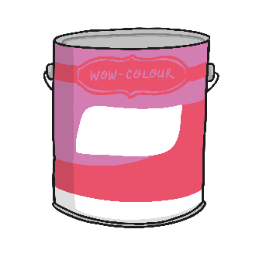
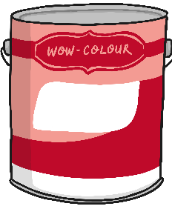
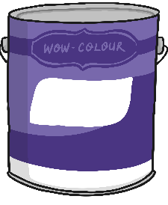

Buying Paint
Jonathan is buying tins of paint to sell in his shop.
How much paint has he bought?
How do you know?

Slide 3
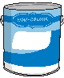

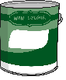
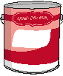

Buying Paint
Jonathan is buying tins of paint to sell in his shop.
10
20
30
40
50
What can you see?
What is the same in each number?
What is different in each number?

Slide 4
Buying Paint
How much paint has he bought?
10
20
30
40
50
60
70
80
90
100

Slide 5
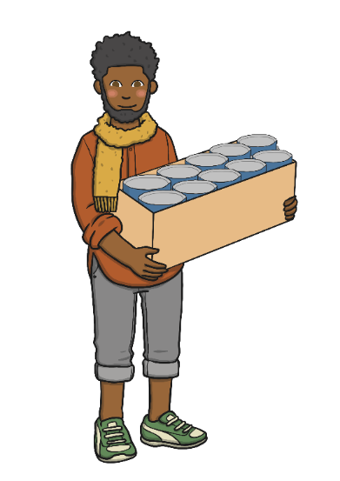
Moving the Paint
Jonathan is taking the paint into his shop. How much does he still have to move?
10
20
30
40
50
60
70
80
90
100

Slide 6
Labelling the Paint
What about now?
100
90
80
70
60
50
40
30
20
10

Slide 7
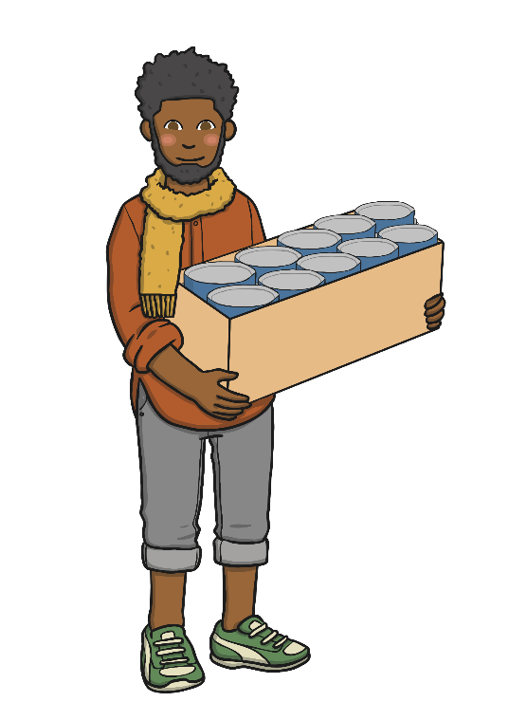
Boxes of Paint
Jonathan put the paint into boxes. There are 10 tins of paint in each box.

Slide 8
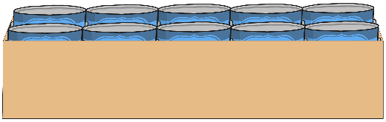
Boxes of Paint
Can you help Jonathan to count the paint?
100
90
80
70
60
50
40
30
20
10

Slide 9
Boxes of Paint
Let’s count again.
100
90
80
70
60
50
40
30
20
10

Slide 10
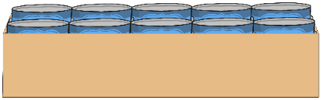
Boxes of Paint
Jonathan carries the boxes into the shop.
How many are left?
100
90
80
70
60
50
40
30
20
10

Slide 11

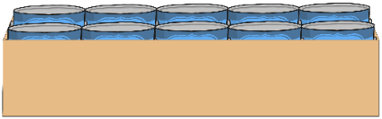
Boxes of Paint
Let’s count again.
100
90
80
70
60
50
40
30
20
10

Slide 12
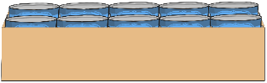
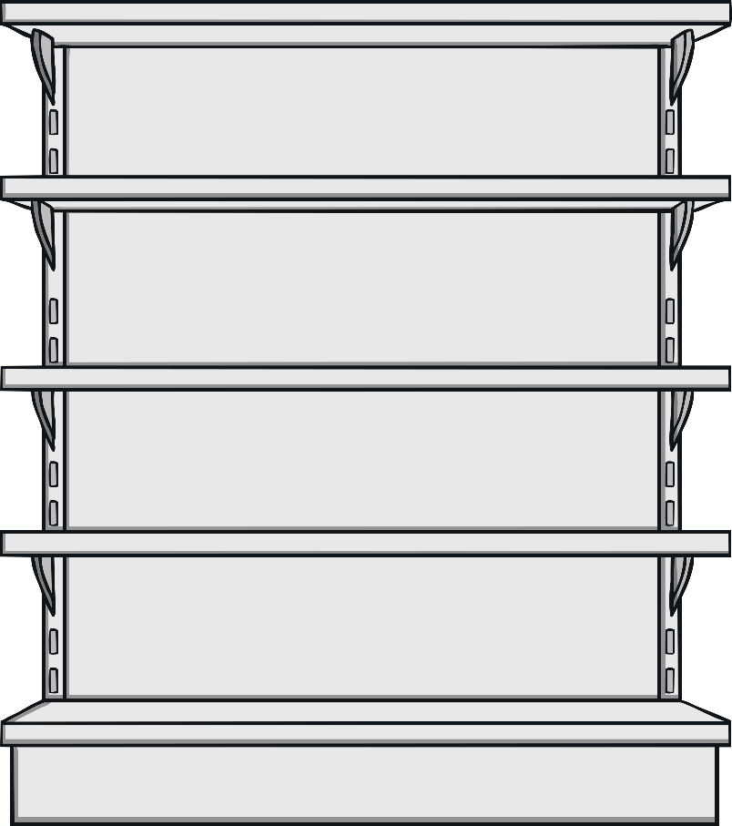
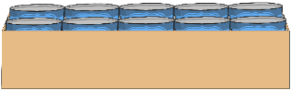
Storage Shelves
Jonathan lines the boxes up on a shelf. He labels them so he knows how many tins of paint he has.
10
20
30
40
50
60
70
80
90
100
Can you finish the labelling for him?

Slide 13




Spilt Paint!
Oh no! Spilt paint! Jonathan can’t see his labels.
10
20
30
40
50
60
70
80
90
100
What are the missing numbers?

Slide 14





Spilt Paint!
Oh no! Spilt paint! Jonathan can’t see his labels.
10
20
30
40
50
60
70
80
90
100
What are the missing numbers?

Slide 15

Spilt Paint!
Oh no! Spilt paint! Jonathan can’t see his labels.
10
20
30
40
50
60
70
80
90
100
What are the missing numbers?

Slide 16
Arranging Boxes
Jonathan arranges his boxes like this.
100
90
80
70
60
50
40
30
20
10

Slide 17
More Spilt Paint!
He spills paint again!
100
90
80
70
60
50
40
30
20
10
What are the missing numbers?

Slide 18
More Spilt Paint!
He spills paint again!
100
90
80
70
60
50
40
30
20
10
What are the missing numbers?

Slide 19



More Spilt Paint!
Paint has covered all the labels. Can you help Jonathan count the missing numbers?
10
20
30
40
50
60
70
80
90
100

Slide 20
More Spilt Paint!
Paint has covered all the labels. Can you help Jonathan count the missing numbers in the opposite order?
100
90
80
70
60
50
40
30
20
10

Slide 21
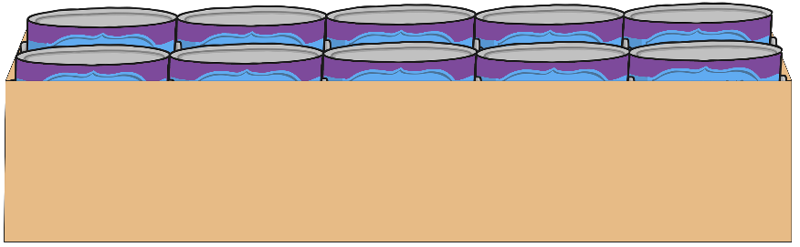
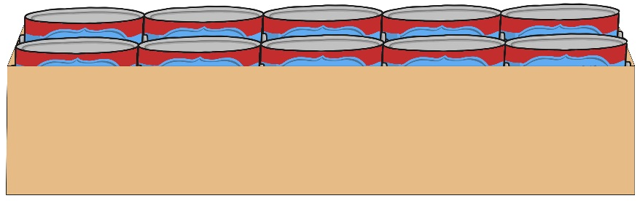
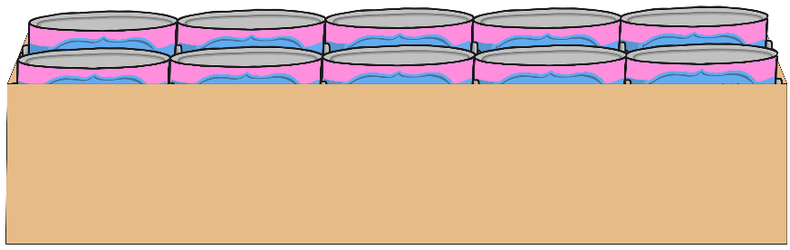
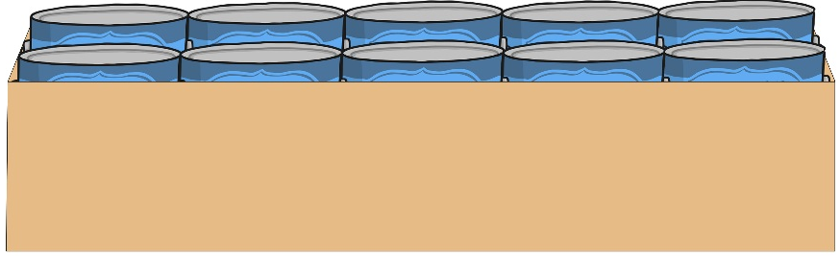
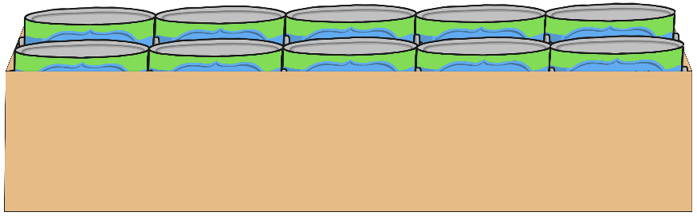
5 Boxes
How many tins of paint?

Slide 22
30 Tins of Paint
How many boxes?

Slide 23
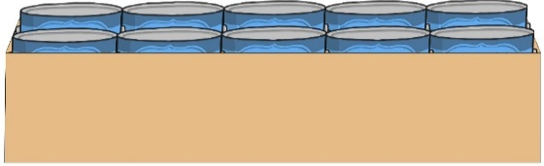
Can You Ask a Question?
Look at the image of the boxes. Can you ask a question about it?

Slide 24
How Much Paint?
Jonathan has an even number of boxes of paint.
All the boxes are full.
He has more than 30 and less than 60 tins of paint.
How many boxes of paint does he have?
Can you make up a puzzle?

