Slide 1
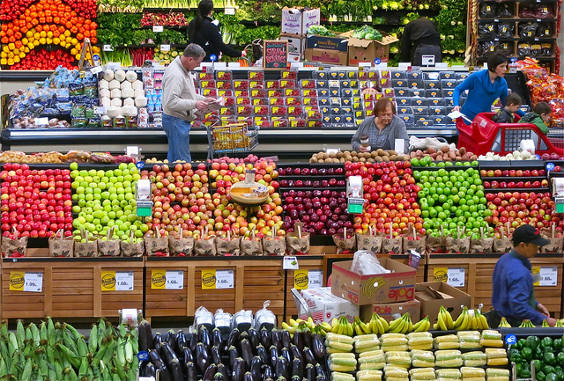
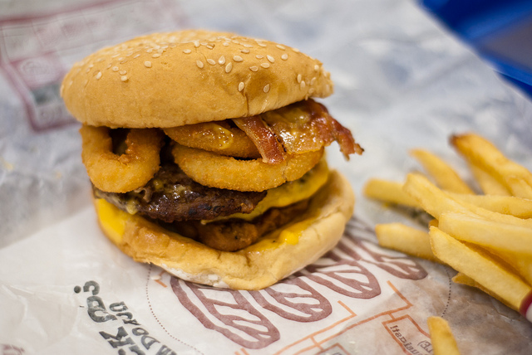
Imagine you live in prehistoric Britain.
Could you get your food from:
a supermarket?
a takeaway?
a local shop?
Notes:
TTYP = talk to your partner
Photos courtesy of:
Supermarket – Dean Hockman@flickr.com
Takeaway - Stefou!@flickr.com

Slide 2
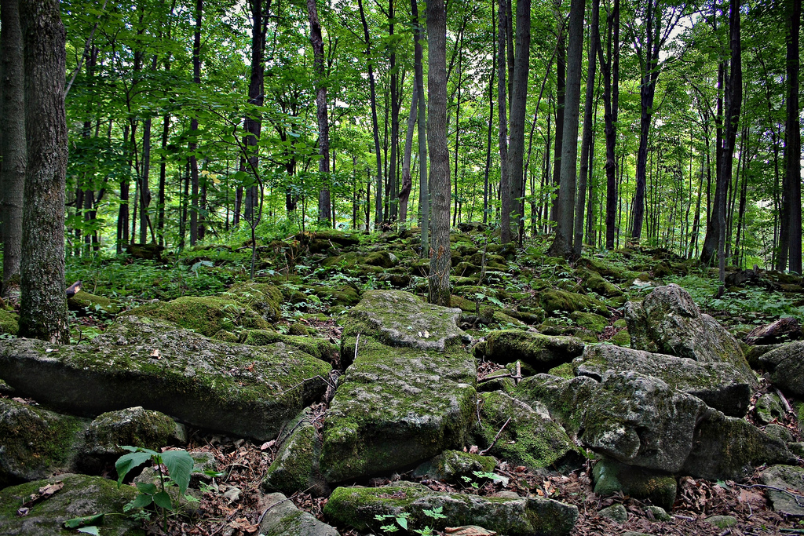
This is your supermarket,
Notes:
Photos courtesy of:
Forest – targut@flickr.com

Slide 3
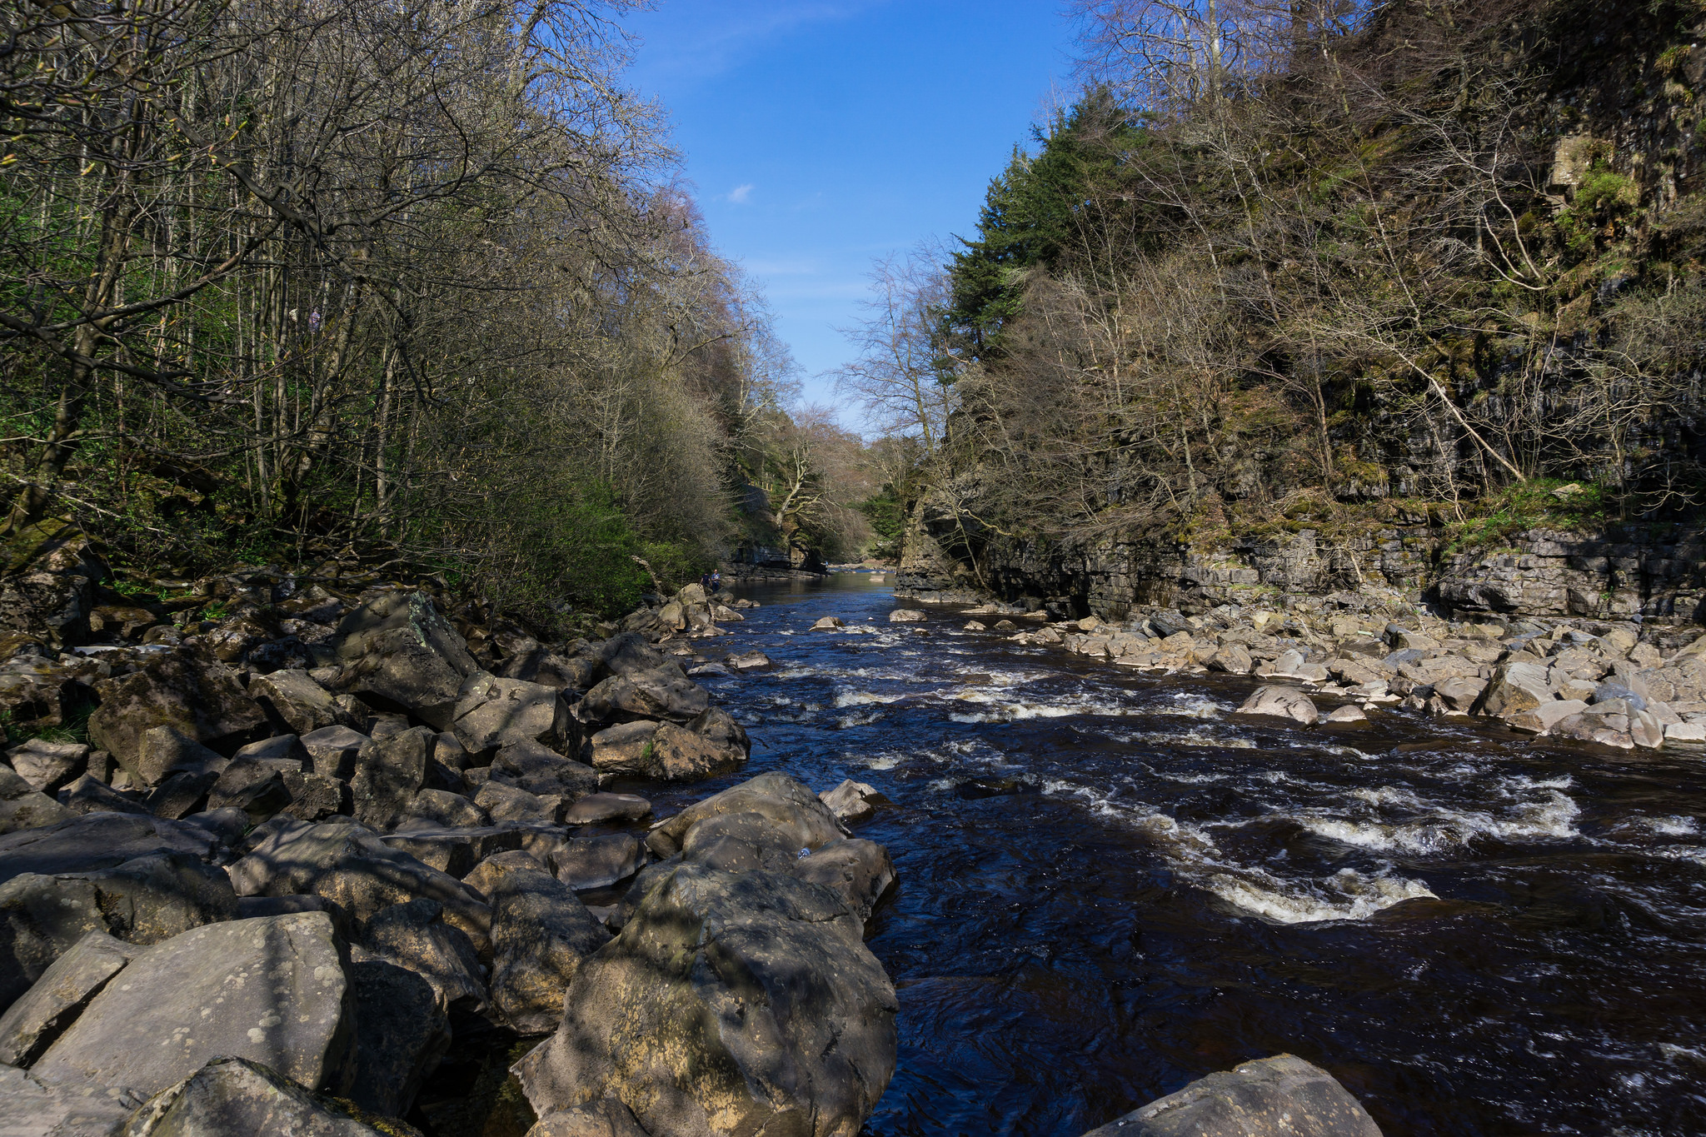
…this is the nearest takeaway…
Notes:
Photos courtesy of:
Forest – barnyz@flickr.com

Slide 4
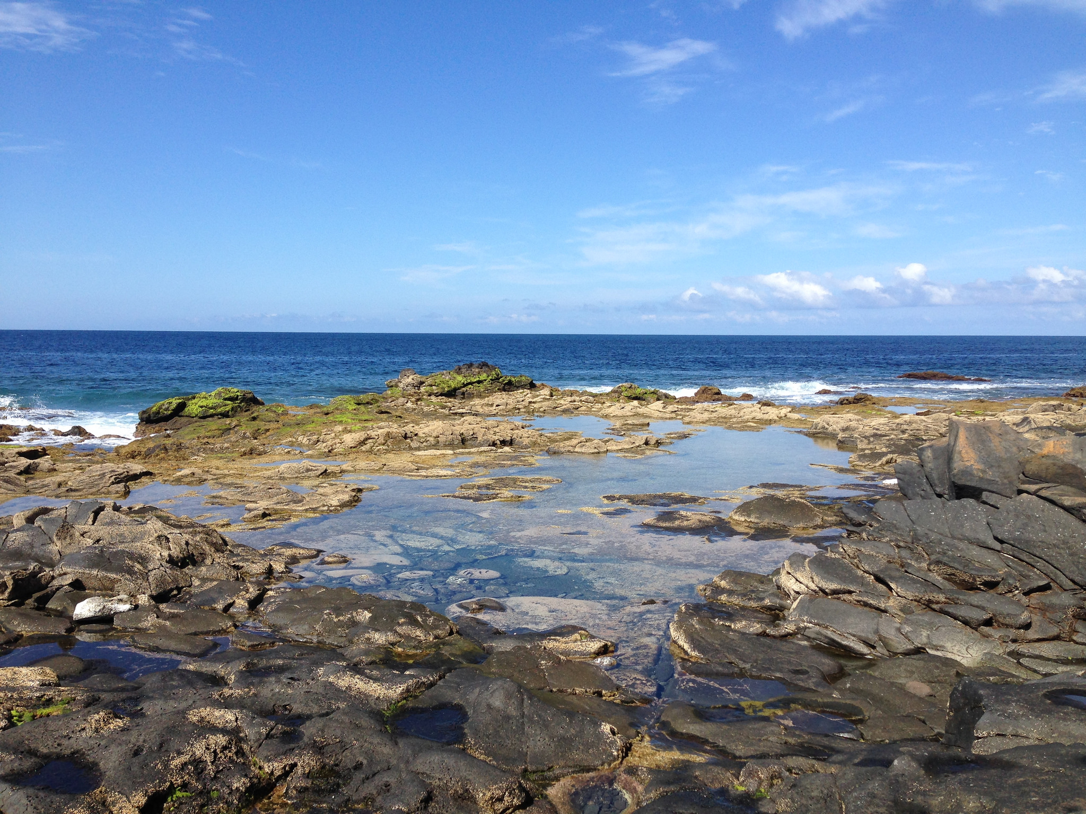
… and this is your local shop.
Notes:
Photos courtesy of:
Coast – Tom Wright@flickr.com

Slide 5
It wasn’t until the Neolithic (4000BC onwards) period that people began to grow food and farm animals.
So for early humans, finding food was essential to survive.
Why do you think we call them
hunter-gatherers?
Notes:
TTYP = talk to your partner

Slide 6
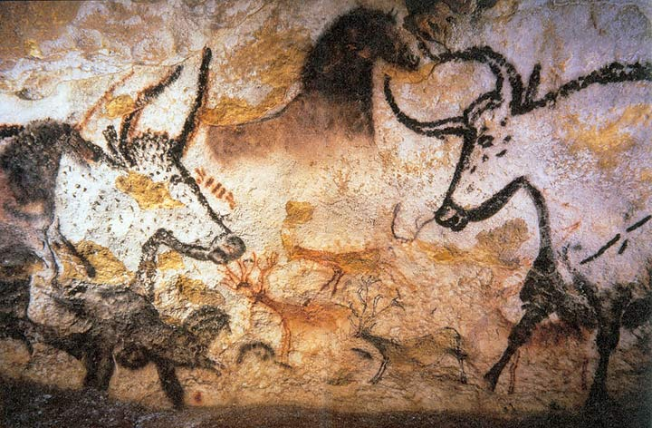
This cave painting from Lascaux in France is 17,300 years old. What kind of animals can you see?
Notes:
Aurochs (an extinct type of wild cattle), horses and deer
Photos courtesy of:
Prof saxx@wikimediacommons

Slide 7
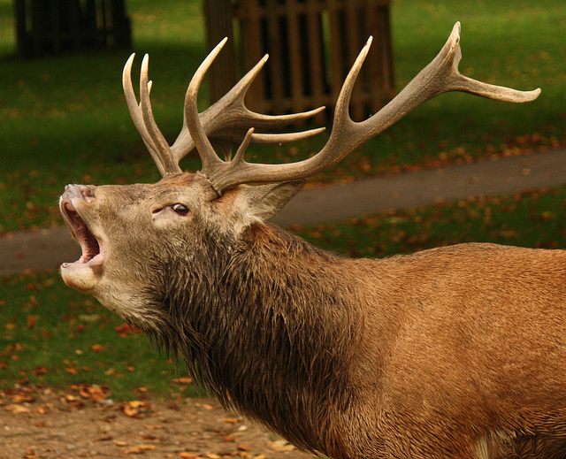
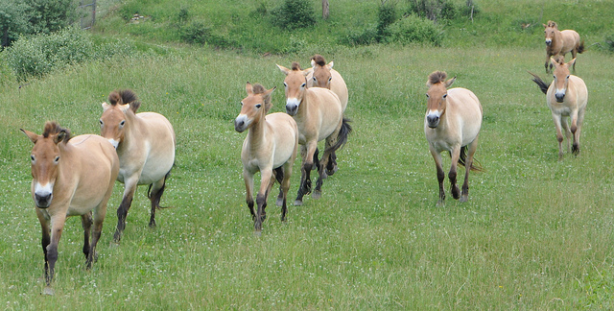
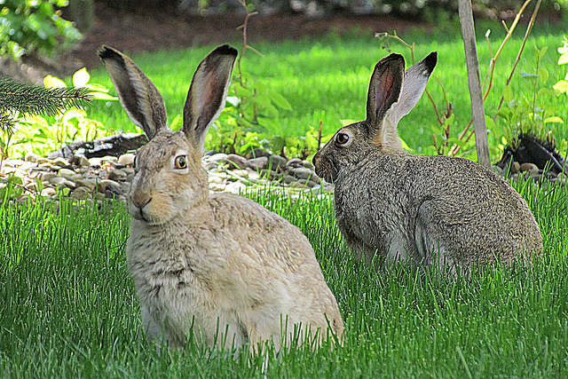
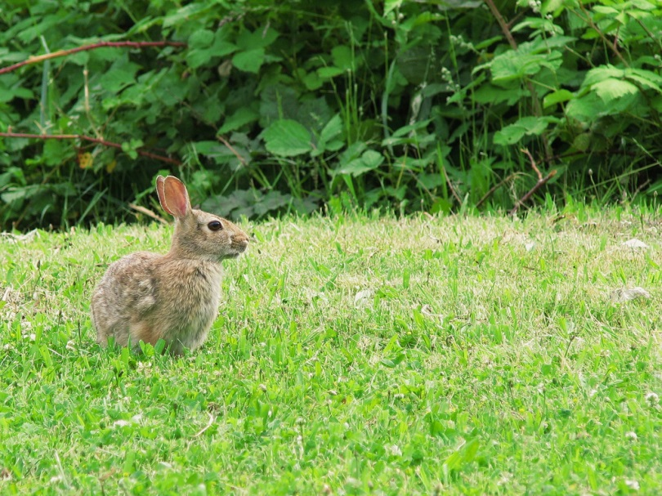
Stone Age people would hunt many animals.
What are these creatures? Would you eat them? TTYP
Notes:
TTYP = talk to your partner
Deer, wild horses, hares, rabbits (shorter ears)
Photos courtesy of:
Deer - Martha de Jong-Lantink@flickr.com
Wild horses - Ted@flickr.com
Hares - Sergei Scurfield@flickr.com
Rabbit – James Hall@flickr.com

Slide 8
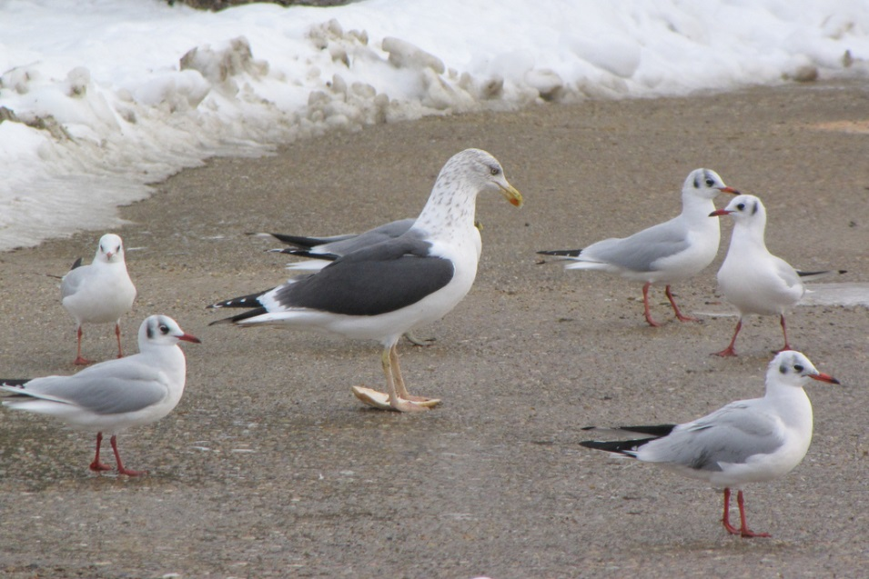
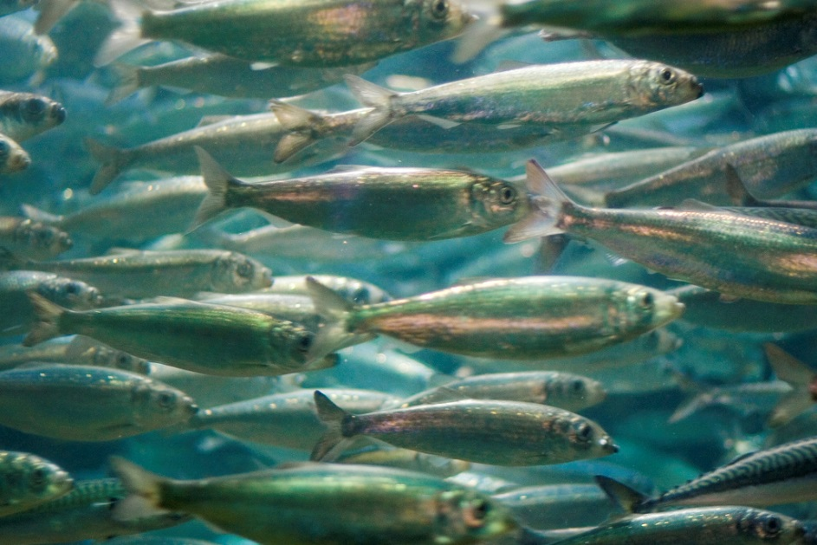
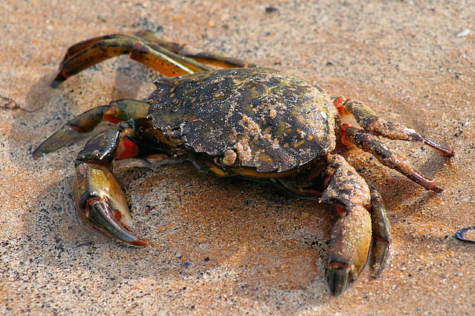
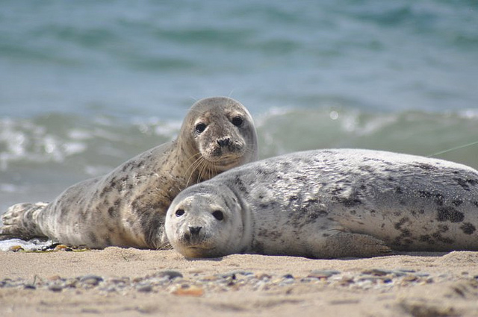
They also hunted animals in rivers and coastal areas.
What are these food sources? TTYP
Notes:
TTYP = talk to your partner
Sea birds, herring, crab, seals
Photos courtesy of:
Seabirds – Dan Davison@flickr.com
Seals – US Fish & Wildlife Service@flickr.com
Herring – Jacob Botter@flickr.com
Crab – John Haslam@flickr.com

Slide 9
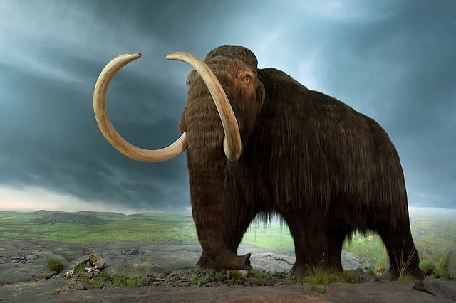
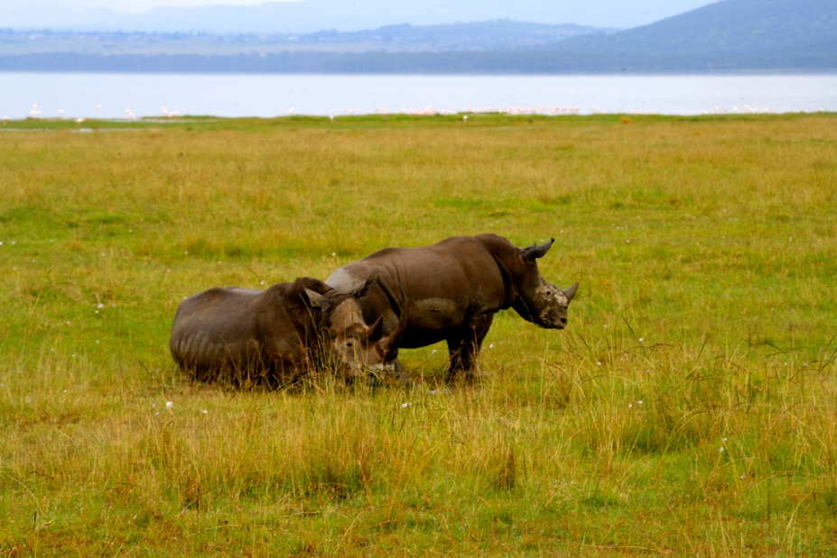
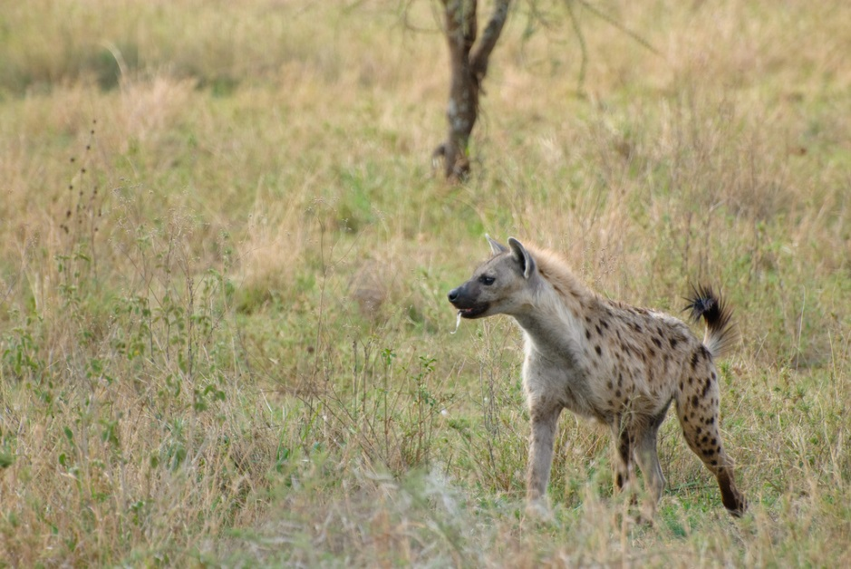
Some of the creatures hunted are now extinct or no longer found in Britain. What are these animals? TTYP
Did you know?
When archaeologist excavated London’s Trafalgar Square in the 1950s, they found a hippopotamus tooth and the remains of elephants!
Notes:
TTYP = talk to your partner
Mammoth, rhino & hyena
Photos courtesy of:
Woolly mammoth – Tyler Ingram@flickr.com
Rhino – Davida de la Harpe@flickr.com
Hyena – Oliver.Dodd@flickr.com

Slide 10
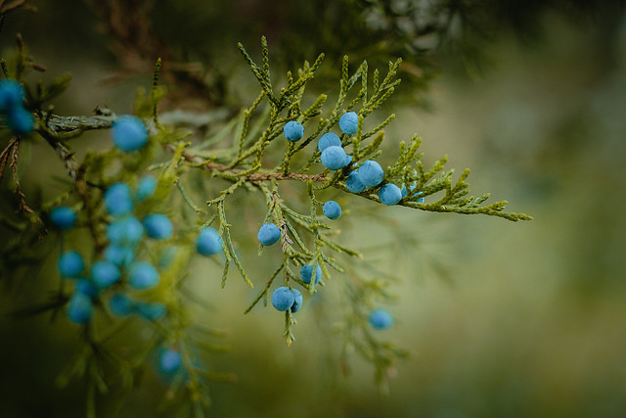
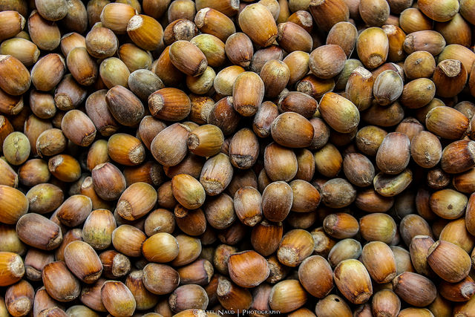
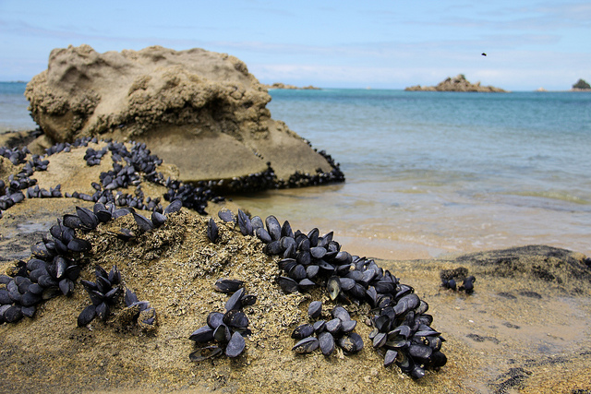
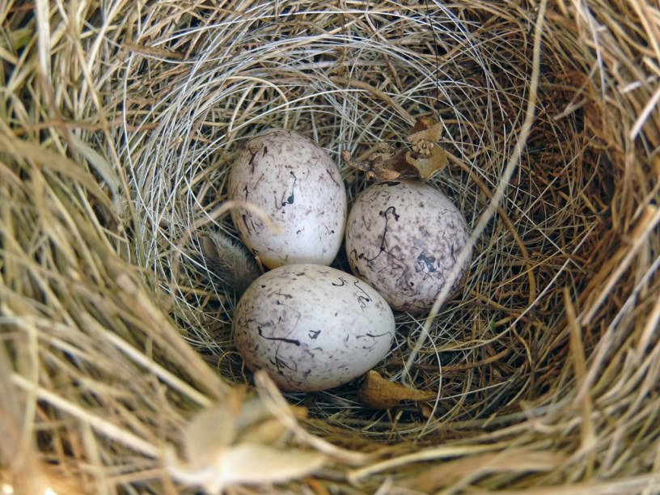
They gathered:
wild berries
hazelnuts
mussels
bird eggs
Notes:
Photos courtesy of:
Juniper berries – Image Catalog@flickr.com
Hazelnuts - Axel Naud@flickr.com
Mussels – Phil King@flickr.com
Bird eggs – NottsExMiner@flickr.com

Slide 11
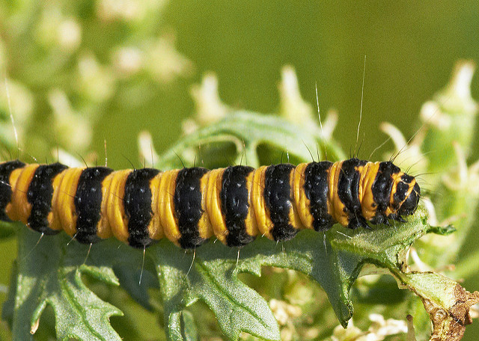
Stone Age people were not fussy! Can you guess these other creatures which they ate?
snails
caterpillar
Notes:
Photos courtesy of:
Snail – Jason Hollinger@flickr.com
Caterpillar – Flickpicpete@flickr.com

Slide 12
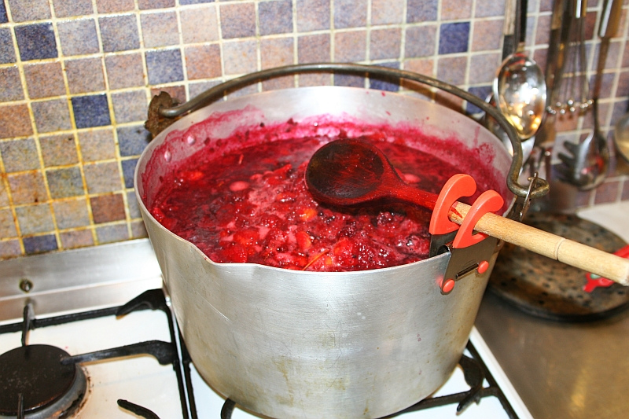
Stewed Fruit
Early humans would cook fruit to preserve it.
Why don’t you try cooking up some fruits and nuts? Hazelnuts with any kind of berries would work.
Stir them together, add honey and slowly bring to the boil.
Simmer for 20 minutes then leave to cool.
Photo courtesy of Clinton ndrwfgg@flickr.com- granted under creative commons licence - attribution

Slide 13
Activity:
Your task is to sort the food into the hunting and gathering columns.

Slide 14
Here is some vocabulary to help you:
deer birds eggs hyenas wild berries mammoth crabs mussels wild horses hazelnuts rhinos fish hares rabbits seeds seals

Slide 15
Extension:
If you finish, draw and label some other foods which Stone Age people would have hunted and gathered.
Notes:
Photos courtesy of:
Seabirds – Dan Davison@flickr.com
Bird eggs – NottsExMiner@flickr.com
Rhino – Davida de la Harpe@flickr.com
Herring – Jacob Botter@flickr.com

Slide 16
Plenary:
Killing large animals could feed a family for months. There were no fridge-freezers so meat would be preserved so it could be eaten later.
Every part of the animal would be eaten including the feet and antlers!
Which other parts of the animals could be used?
What could they be used for?
Notes:
TTYP = talk to your partner
Photos courtesy of:
Woolly mammoth – Tyler Ingram@flickr.com
Deer - Martha de Jong-Lantink@flickr.com

