Slide 1
Draw Line Graphs
Diving
A cyclist is travelling from his home in England to Scotland. The data shows how far from home he was at the end of each day. Yasmin is drawing a line graph of the data.
She has started the graph and has labelled the x-axis
What intervals should Yasmin use on the
y-axis – multiples of 10, multiples of 50 or multiples of 100?
What intervals should Yasmin use on the
y-axis – multiples of 10, multiples of 50 or multiples of 100?
100
90
80
70
60
50
40
30
20
10
0
Monday | 50km
Tuesday | 90km
Wednesday | 210km
Thursday | 295km
Friday | 330km
Saturday | 410km
Sunday | 480km
Multiples of 10 would not be large enough.
M
T
W
T
F
S
S
Days

Slide 2
Draw Line Graphs
Diving
A cyclist is travelling from his home in England to Scotland. The data shows how far from home he was at the end of each day. Yasmin is drawing a line graph of the data.
She has started the graph and has labelled the x-axis
What intervals should Yasmin use on the
y-axis – multiples of 10, multiples of 50 or multiples of 100?
What intervals should Yasmin use on the
y-axis – multiples of 10, multiples of 50 or multiples of 100?
Monday | 50km
Tuesday | 90km
Wednesday | 210km
Thursday | 295km
Friday | 330km
Saturday | 410km
Sunday | 480km
500
450
400
350
300
250
200
150
100
50
0
Multiples of 50 would be large enough to fit the greatest distance on.
M
T
W
T
F
S
S
Days

Slide 3
Draw Line Graphs
Diving
A cyclist is travelling from his home in England to Scotland. The data shows how far from home he was at the end of each day. Yasmin is drawing a line graph of the data.
She has started the graph and has labelled the x-axis
What intervals should Yasmin use on the
y-axis – multiples of 10, multiples of 50 or multiples of 100?
What intervals should Yasmin use on the
y-axis – multiples of 10, multiples of 50 or multiples of 100?
Monday | 50km
Tuesday | 90km
Wednesday | 210km
Thursday | 295km
Friday | 330km
Saturday | 410km
Sunday | 480km
1000
900
800
700
600
500
400
300
200
100
0
Multiples of 100 would be large enough to fit the greatest distance but there would be a lot of the graph paper not used.
M
T
W
T
F
S
S
Days

Slide 4
Draw Line Graphs
Diving
A cyclist is travelling from his home in England to Scotland. The data shows how far from home he was at the end of each day. Yasmin is drawing a line graph of the data.
She has started the graph and has labelled the x-axis
What intervals should Yasmin use on the
y-axis – multiples of 10, multiples of 50 or multiples of 100?
What intervals should Yasmin use on the
y-axis – multiples of 10, multiples of 50 or multiples of 100?
500
450
400
350
300
250
200
150
100
50
0
Monday | 50km
Tuesday | 90km
Wednesday | 210km
Thursday | 295km
Friday | 330km
Saturday | 410km
Sunday | 480km
Multiples of 50 would be best.
M
T
W
T
F
S
S
Days

Slide 5
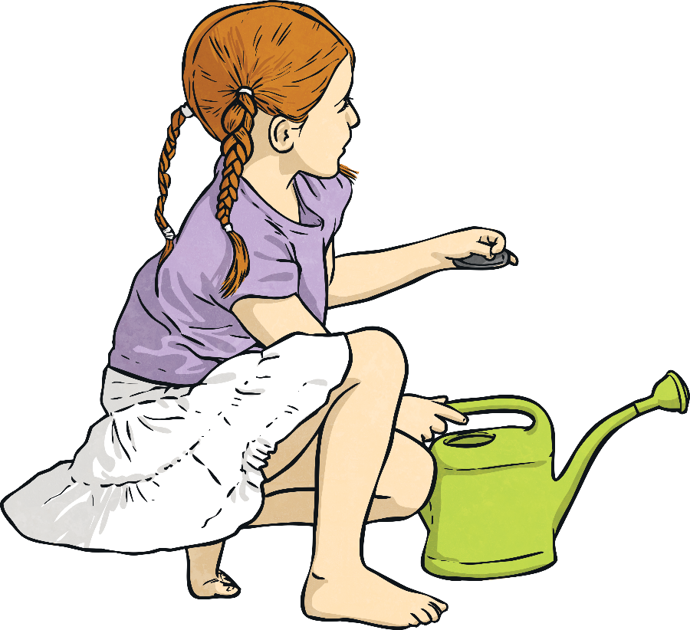
Draw Line Graphs
Deeper
Two children are growing plants. This is how they grew over the first 3 weeks:
 | Start | Week 1 | Week 2 | Week 3
Suzie | 10cm | 18cm | 29cm | 35cm
Sam | 15cm | 24cm | 32cm | 46cm
The data in the table is going to be recorded as a line graph on this piece of paper.

Slide 6
Draw Line Graphs
Deeper
Two children are growing plants. This is how they grew over the first 3 weeks:
 | Start | Week 1 | Week 2 | Week 3
Suzie | 10cm | 18cm | 29cm | 35cm
Sam | 15cm | 24cm | 32cm | 46cm
The data in the table is going to be recorded as a line graph on this piece of paper.
What intervals should Yasmin use on the
y-axis – multiples of 10, multiples of 50 or multiples of 100?
Here are some things different children said about how to draw the graph using cm² paper. Which ones do you agree with? If you do not agree, explain why.
Dan
The x-axis should show the height.
On a line graph, the
x-axis normally shows the passage of time.
Mo
The y-axis should have increments which are multiples of 5.
Ben
The x-axis should show the time.
Kyle
The y-axis should have increments which are multiples of 2.

Slide 7
Draw Line Graphs
Deeper
Two children are growing plants. This is how they grew over the first 3 weeks:
 | Start | Week 1 | Week 2 | Week 3
Suzie | 10cm | 18cm | 29cm | 35cm
Sam | 15cm | 24cm | 32cm | 46cm
The data in the table is going to be recorded as a line graph on this piece of paper.
What intervals should Yasmin use on the
y-axis – multiples of 10, multiples of 50 or multiples of 100?
Here are some things different children said about how to draw the graph using cm² paper. Which ones do you agree with? If you do not agree, explain why.
Dan
The x-axis should show the height.
Mo
The y-axis should have increments which are multiples of 5.
✓
Ben
The x-axis should show the time.
Kyle
The y-axis should have increments which are multiples of 2.

Slide 8
Draw Line Graphs
Deeper
Two children are growing plants. This is how they grew over the first 3 weeks:
 | Start | Week 1 | Week 2 | Week 3
Suzie | 10cm | 18cm | 29cm | 35cm
Sam | 15cm | 24cm | 32cm | 46cm
The data in the table is going to be recorded as a line graph on this piece of paper.
What intervals should Yasmin use on the
y-axis – multiples of 10, multiples of 50 or multiples of 100?
Here are some things different children said about how to draw the graph using cm² paper. Which ones do you agree with? If you do not agree, explain why.
Dan
The x-axis should show the height.
Mo
The y-axis should have increments which are multiples of 5.
Ben
The x-axis should show the time.
✓
Kyle
The y-axis should have increments which are multiples of 2.

Slide 9
Draw Line Graphs
Deeper
Two children are growing plants. This is how they grew over the first 3 weeks:
 | Start | Week 1 | Week 2 | Week 3
Suzie | 10cm | 18cm | 29cm | 35cm
Sam | 15cm | 24cm | 32cm | 46cm
The data in the table is going to be recorded as a line graph on this piece of paper.
What intervals should Yasmin use on the
y-axis – multiples of 10, multiples of 50 or multiples of 100?
Here are some things different children said about how to draw the graph using cm² paper. Which ones do you agree with? If you do not agree, explain why.
Dan
The x-axis should show the height.
If the y-axis was divided into multiples of 2, the paper would not be big enough for the greatest height (46cm).
Mo
The y-axis should have increments which are multiples of 5.
Ben
The x-axis should show the time.
Kyle
The y-axis should have increments which are multiples of 2.

