Slide 1
Floodland
By Marcus Sedgwick

Slide 2
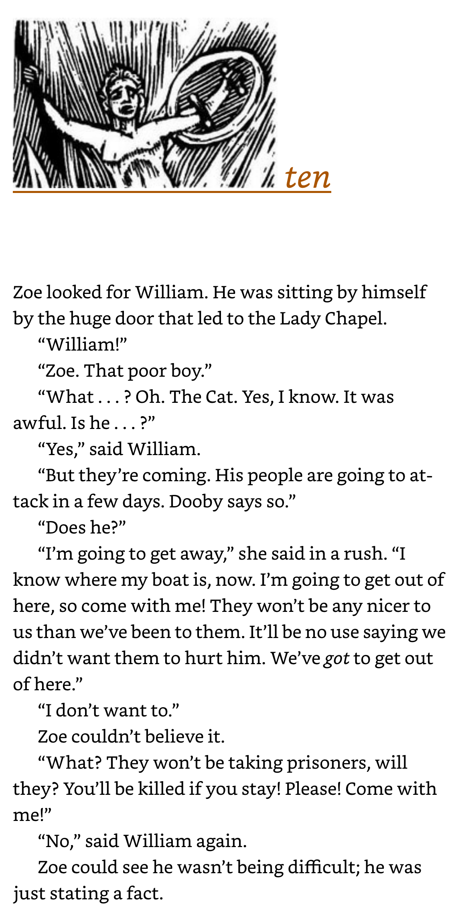

Slide 3
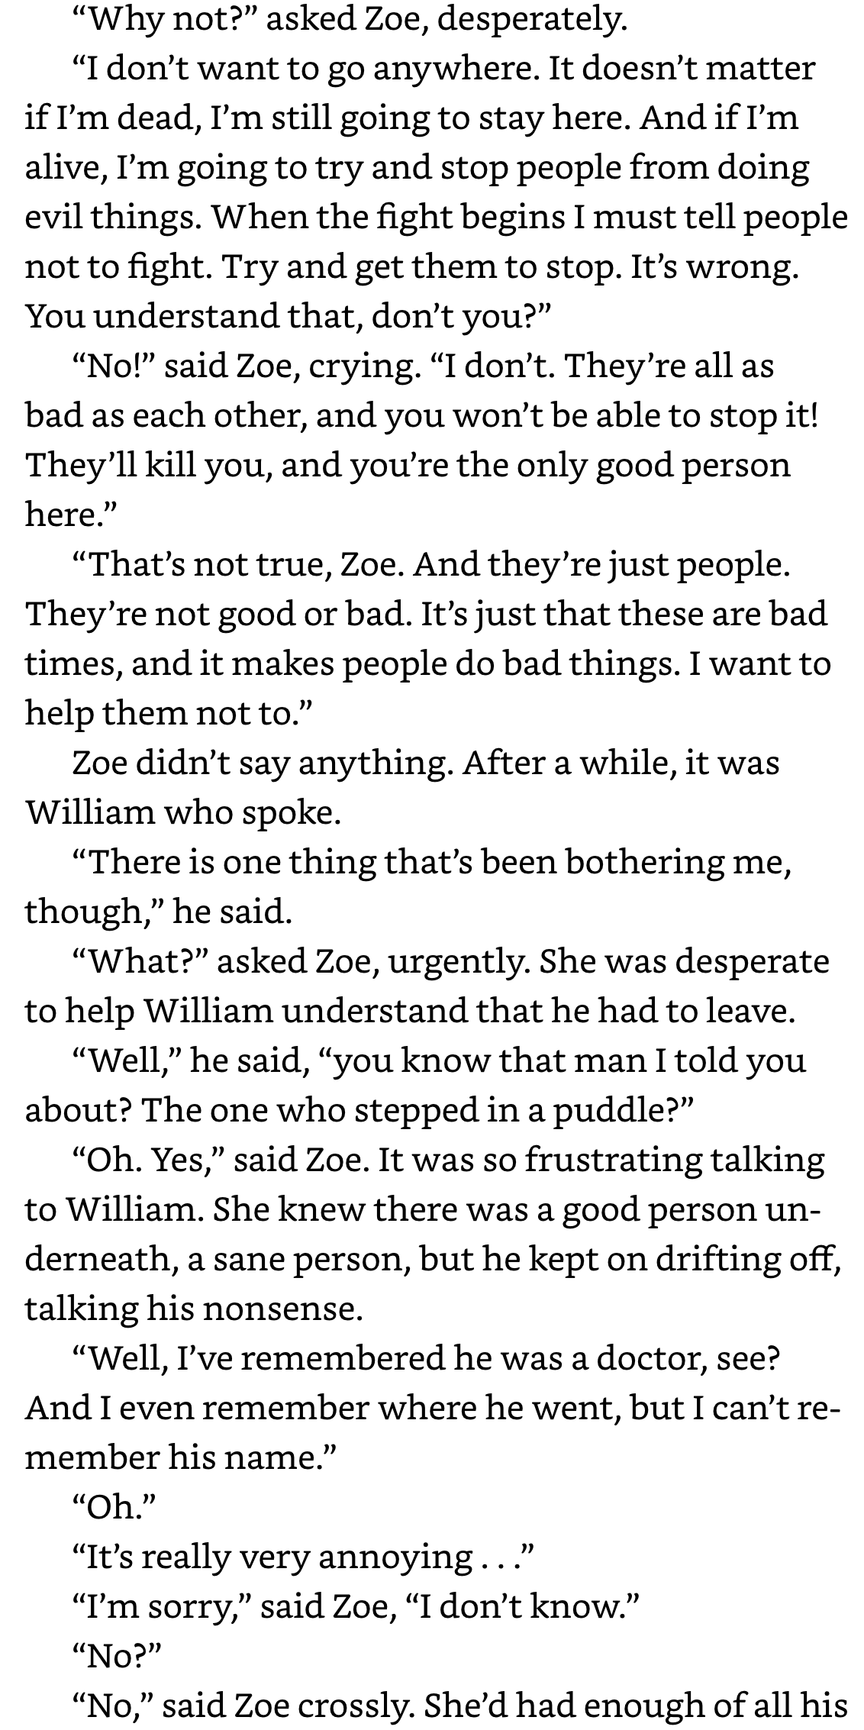

Slide 4
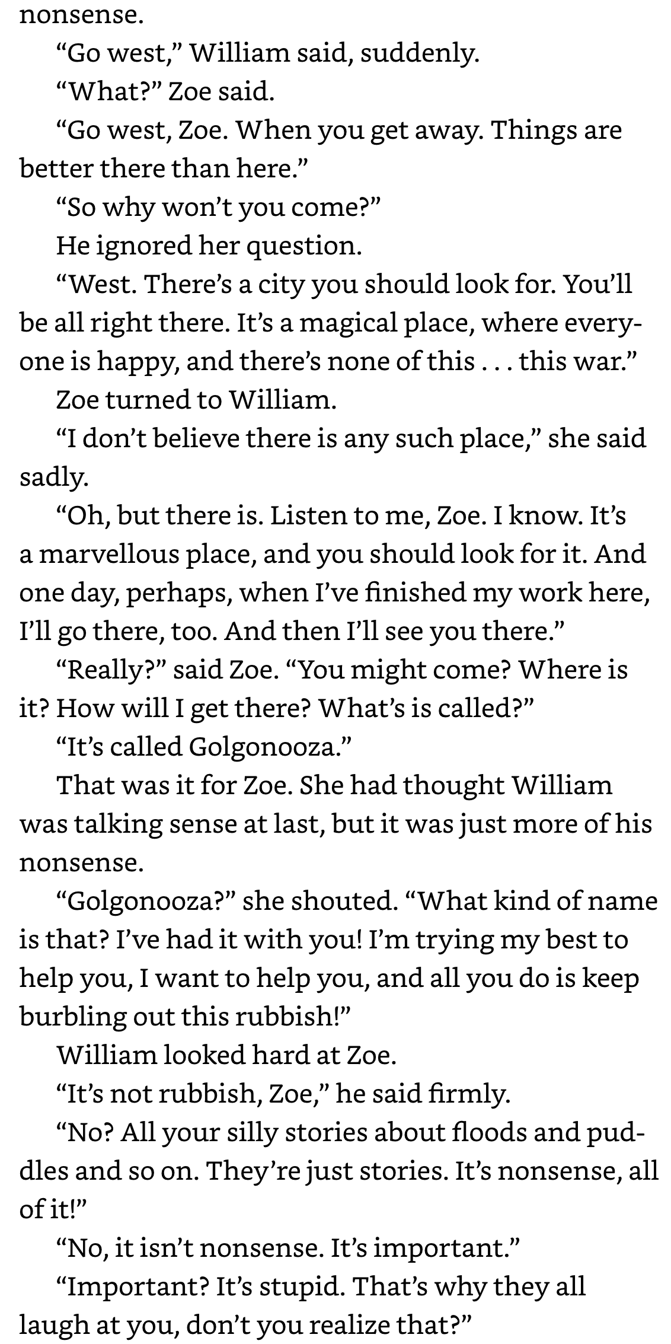

Slide 5
