Slide 1
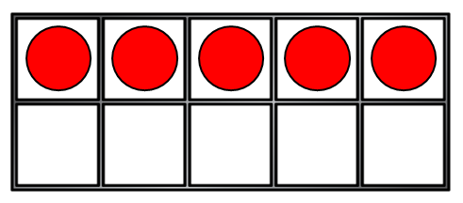
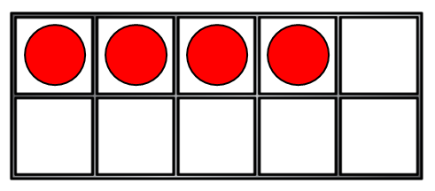
1) What is one more than 11?
2) 6 + ? = 8
3) How many?
4) These are number bonds to ___
5 + 2
3 + 4

Slide 2
1) What is one more than 11?
2) 6 + ? = 8
3) How many?
4) These are number bonds to ___
12
2
9
7
5 + 2
3 + 4

Slide 3
What are number bonds to 10?

Slide 4
They are pairs of numbers that add up to 10.
Let’s find some number bonds to 10.

Slide 5
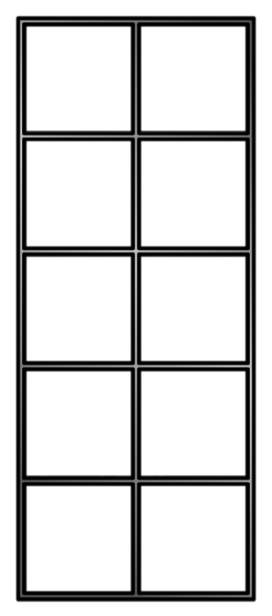
Number bonds to 10
$$+$$
___
___

Slide 6
Number bonds to 10
$$+$$
10
0

Slide 7
Number bonds to 10
$$+$$
___
___

Slide 8
Number bonds to 10
$$+$$
9
1

Slide 9
Number bonds to 10
$$+$$
___
___

Slide 10
Number bonds to 10
$$+$$
8
2

Slide 11
Number bonds to 10
$$+$$
___
___

Slide 12
Number bonds to 10
$$+$$
7
3

Slide 13
Number bonds to 10
$$+$$
___
___

Slide 14
Number bonds to 10
$$+$$
6
4

Slide 15
Number bonds to 10
$$+$$
___
___

Slide 16
Number bonds to 10
$$+$$
5
5

Slide 17
Number bonds to 10
$$+$$
___
___

Slide 18
Number bonds to 10
$$+$$
4
6

Slide 19
Number bonds to 10
$$+$$
___
___

Slide 20
Number bonds to 10
$$+$$
3
7

Slide 21
Number bonds to 10
$$+$$
___
___

Slide 22
Number bonds to 10
$$+$$
2
8

Slide 23
Number bonds to 10
$$+$$
___
___

Slide 24
Number bonds to 10
$$+$$
1
9

Slide 25
Number bonds to 10
$$+$$
___
___

Slide 26
Number bonds to 10
$$+$$
0
10

Slide 27
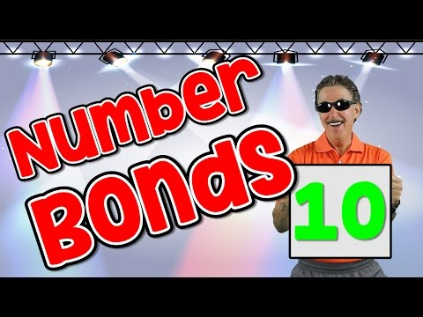

Slide 28
7.1.21
10 + 0 = 10
1 + 9 = 10

