Slide 2
If you want to read a simpler version of the story, please read Slides 3 – 6.
If you want to read a more detailed version of the story, please read Slides 7 – 12.
Using one of the stories, create your storyboard.

Slide 3
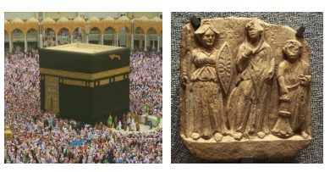

Slide 5
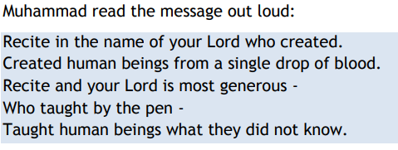

Slide 7
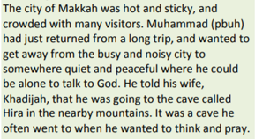
FIRST PICTURE TO DRAW

Slide 8
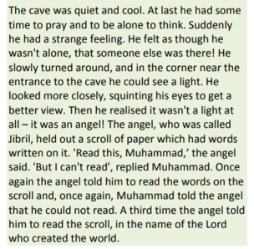
SECOND PICTURE TO DRAW

Slide 9
THIRD PICTURE TO DRAW

Slide 10
FOURTH PICTURE TO DRAW

Slide 11
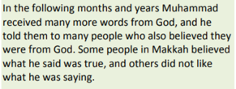
FIFTH PICTURE TO DRAW

Slide 12
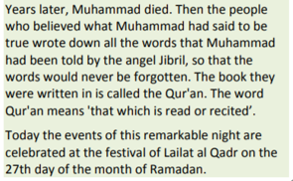
SIXTH PICTURE TO DRAW

