Slide 1
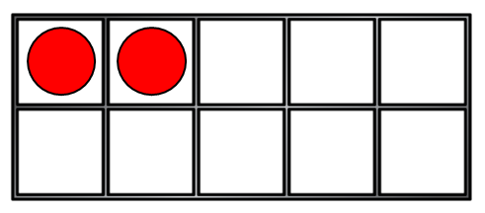
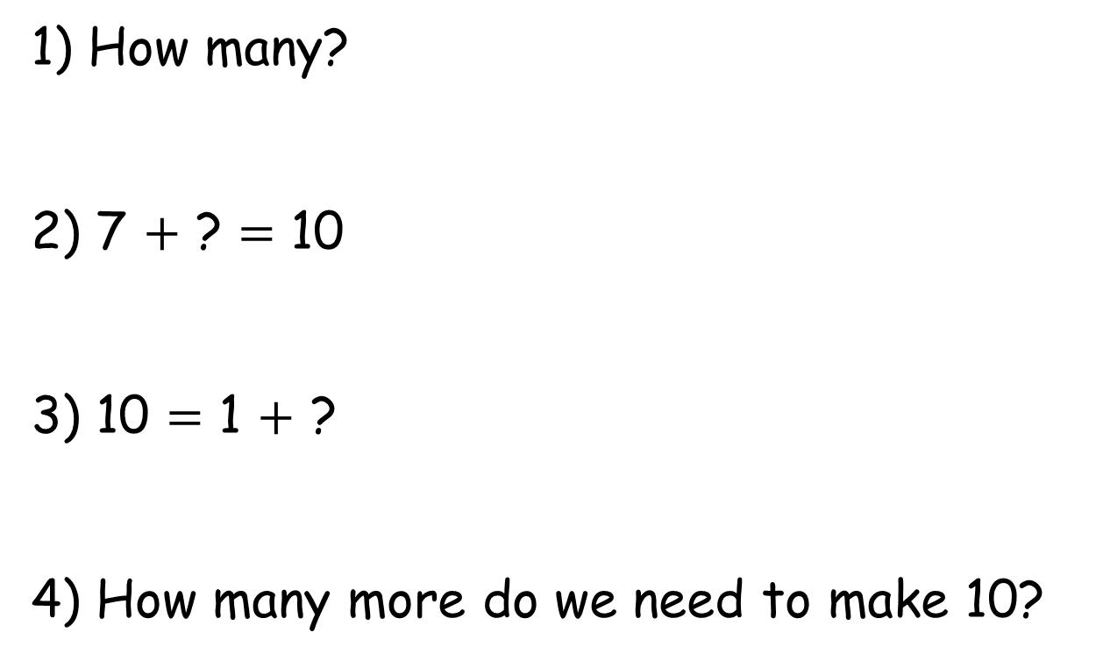
1) How many?
2) 7 $+$ ? $=$ 10
3) 10 $=$ 1 $+$ ?
4) How many more do we need to make 10?

Slide 2
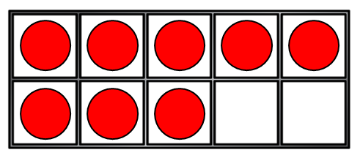
1) How many?
2) 7 $+$ ? $=$ 10
3) 10 $=$ 1 $+$ ?
4) How many more do we need to make 10?
10
3
9
8

Slide 3
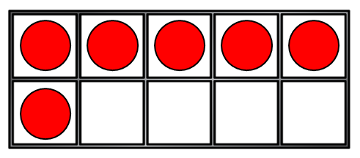
Making 10
Amir and Eva are practising their number bonds to 10
You need … more!
6
I have…
4

Slide 4
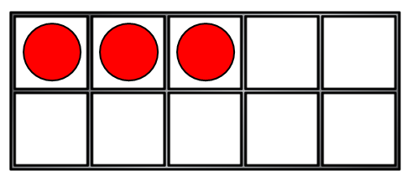
Making 10
Amir and Eva are practising their number bonds to 10
You need … more!
3
I have…
7

Slide 5
Have a think
Making 10
Amir and Eva are practising their number bonds to 10
You need … more!
8
I have…
2

Slide 6
Let’s do some addition using a number line!
3 + 16 = ___

Slide 7
Let’s do some addition using a number line!
3 + 16 = 19

Slide 8
That took a long time and a lot of jumps!
Did you know that addition can be done any way round?
3 + 16 is the same as 16 + 3

Slide 9
Let’s try!
Solve this question using a number line.
16 + 3 = __

Slide 10
Let’s try!
Solve this question using a number line.
16 + 3 = 19

Slide 11
That was much quicker as we had to do less jumps!
We were still adding 3 and 16 together.
It’s usually better to start with the largest number to solve an addition.

Slide 12
Let’s try!
2 + 12 =
That would be a lot of jumps, so lets start with the largest number. Let’s swap the numbers around.
12 + 2 =

Slide 13
Let’s try!
2 + 12 = 14
That would be a lot of jumps, so lets start with the largest number. Let’s swap the numbers around.
12 + 2 = 14

Slide 14
Let’s try some more using our number lines.

Slide 15
