Slide 1
PSHE and Citizenship
Living in the Wider World | Aiming High
PSHE and Citizenship | KS1 | Living in the Wider World | Aiming High | Star Qualities | Lesson 1

Slide 3
Aim
I can think of star qualities I already have and those I would like to develop.
Success Criteria
I can talk about my star qualities.
I can talk about star qualities in others.
I can think about how I could develop certain qualities.
This resource is fully in line with the Learning Outcomes and Core Themes outlined in the PSHE Association’s Programme of Study.

Slide 4
The Big Questions

Slide 5
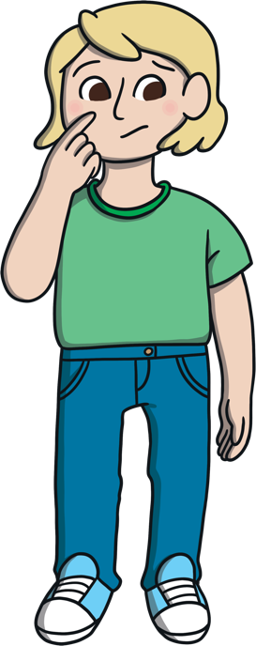
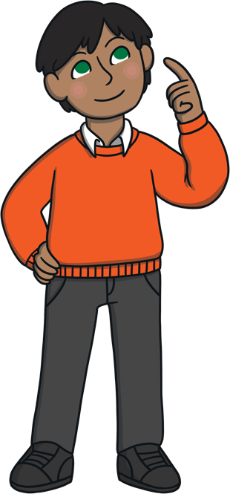
What are our
star qualities?
What star qualities would we like to develop?
Share your thoughts with your friends.

Slide 6
Reconnecting

Slide 7
What Is a Star Quality?
We are all unique and have lots of things which make us special, things that we are good at. This is exciting!
What might our star qualities be? We might be…
strong
hard-working
loyal
generous
honest
a good listener
thoughtful
funny
careful
positive
friendly
respectful
grateful
patient
loving
fair
kind
responsible
co-operative
supportive
determined

Slide 8
Exploring

Slide 9
What Are Our Star Qualities?
Today, we will be thinking about our star qualities – all of the things which we are really good at and that make us special!
Think about what your own star qualities are.
Talk about them with your group.
Thinking about our star qualities can help us to feel happy and confident. It reminds us of all the good things about ourselves. Try and remember these, especially when you are feeling sad or worried about something.
Then, write down or draw as many as you can on the paper using colourful pens.
Remember to help your friends if they need it.
Now, if you feel happy to, share some of your star qualities with the class.

Slide 10
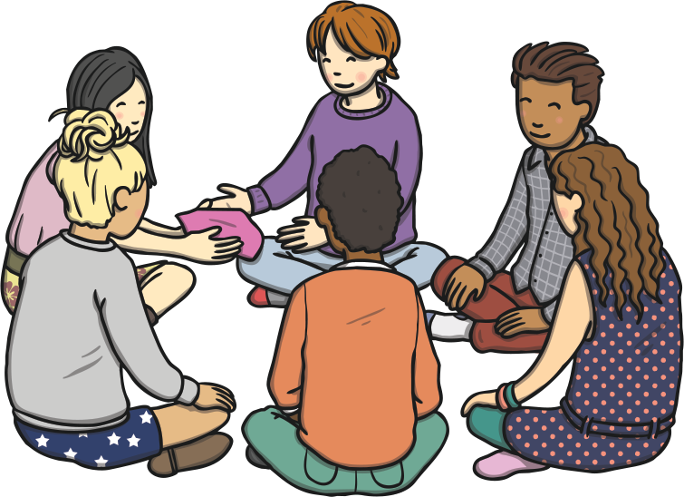
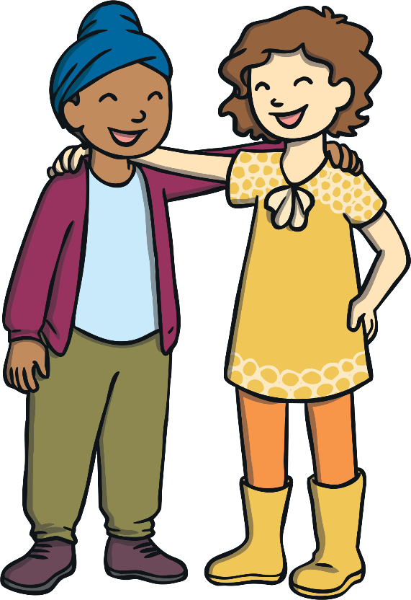
Shining Stars
It is really good to think about our own star qualities.
It is also important to think about the star qualities of our friends. It can help us appreciate each other.
By telling our friends what we think their star qualities are, we can help them to feel happy.
Take a name of a classmate from the box. Remember not to tell anyone who you have picked!
On your sticky note, write or draw something that you think is a star quality of the classmate whose name you picked.

Slide 11
Shining Stars
When you are invited to, please can you stick your note in front of the person that it is for.
Now, one at a time, we will share the star qualities that our friends think we have.
How does hearing what others think your star qualities are make you feel?
Sharing what we think is great about others can make them, and us, feel good! Let’s always remember to tell others what their star qualities are.

Slide 12
Consolidating
Reflecting

Slide 13
Consolidating

Slide 14
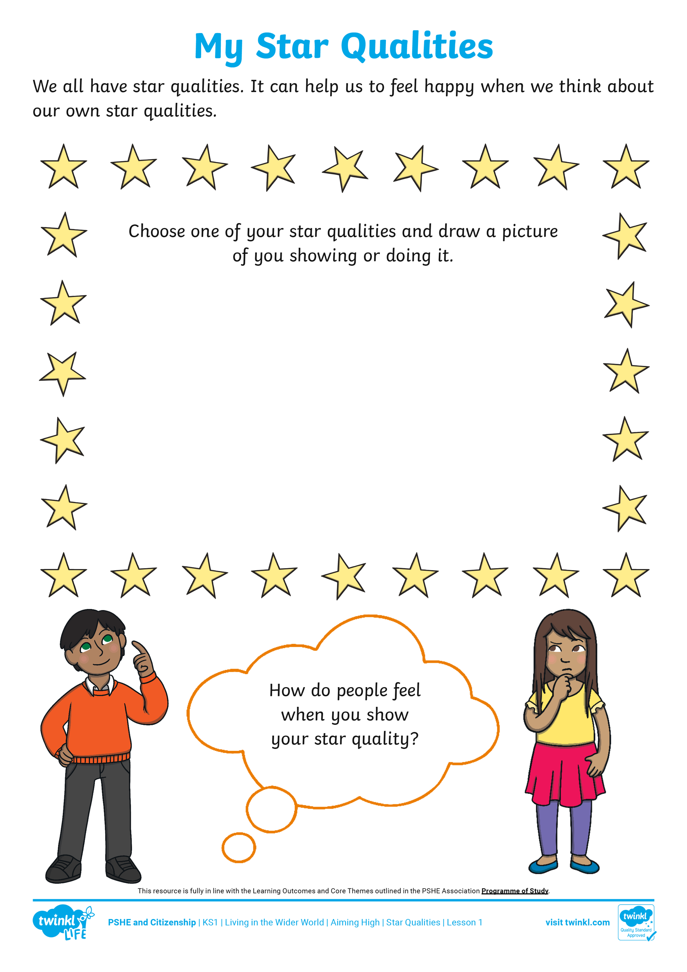
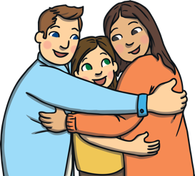
My Star Qualities
Complete the My Star Qualities Activity Sheet to show one of your star qualities.
Draw a picture of yourself showing your chosen star quality. Think about how people feel when you show this. Write or draw your ideas in the thought bubble.

Slide 15
Reflecting

Slide 16
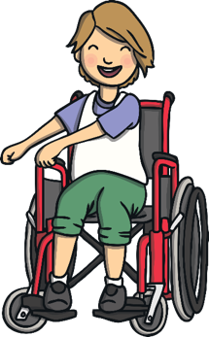
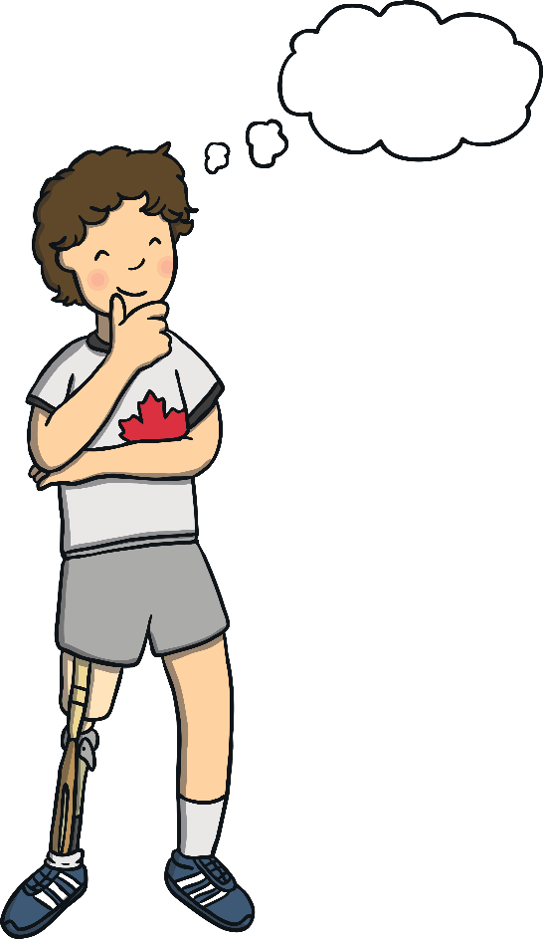
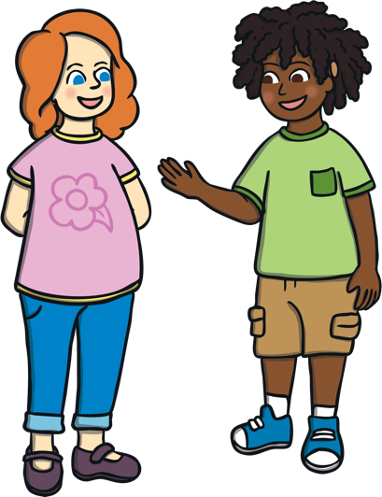
Take Time to Shine
Are there any star qualities we have talked about today that you would like to get even better at and develop?
Take some time to think about this and then share your thoughts with a partner.

Slide 17
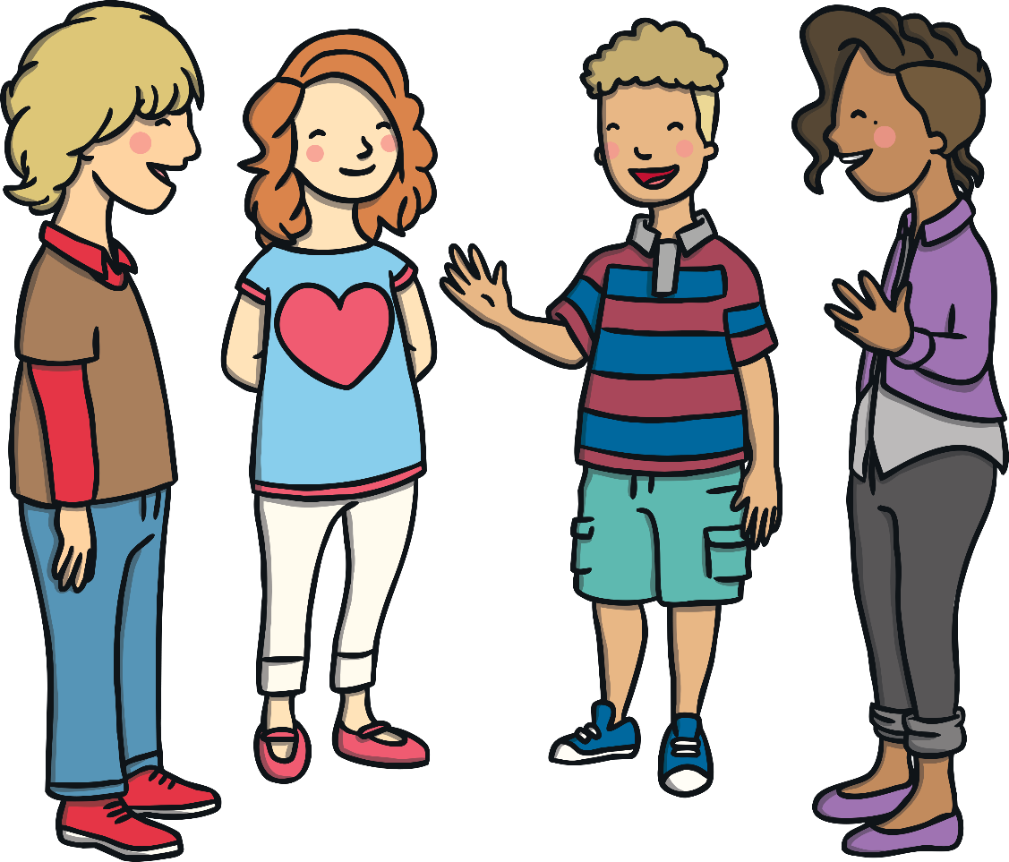
Take Time to Shine
Can you tell your partner why you would like to develop the star quality you have chosen?
Talk together about how you could develop your chosen star quality.
What a lot of wonderful ideas! Let’s all take the time to shine, show our star qualities and make our class a happy place!

Slide 18
The Big Questions

Slide 19
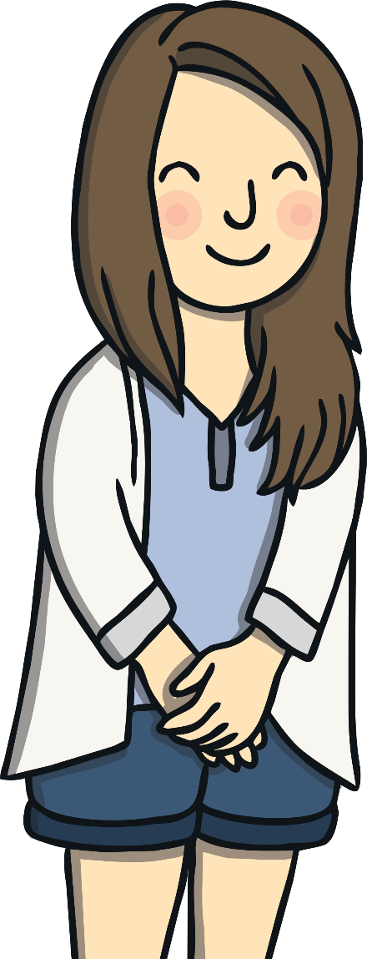
What are our
star qualities?
What star qualities would we like to develop?
What is the most interesting thing you have learnt today?

Slide 20
Aim
I can think of star qualities I already have and those I would like to develop.
Success Criteria
I can talk about my star qualities.
I can talk about star qualities in others.
I can think about how I could develop certain qualities.
This resource is fully in line with the Learning Outcomes and Core Themes outlined in the PSHE Association’s Programme of Study.

