Slide 1
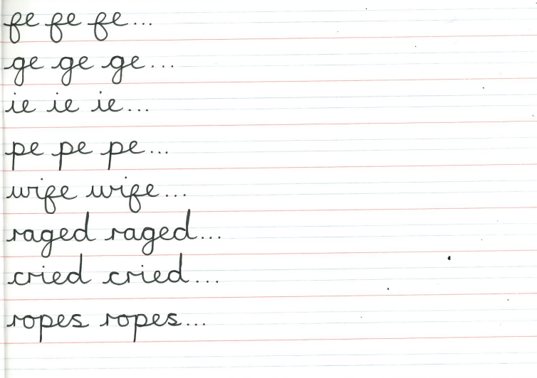
HANDWRITING
LESSON 1
12/01/21

Slide 2
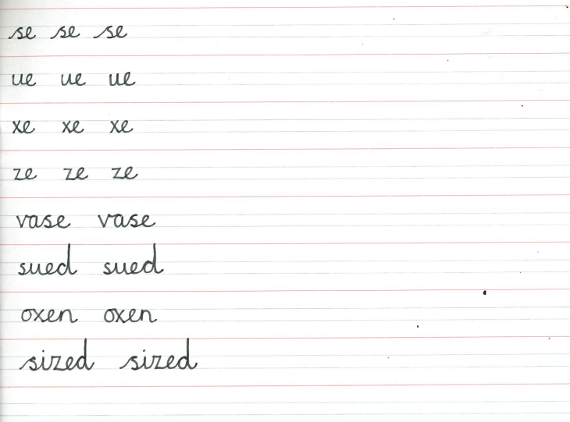
HANDWRITING
LESSON 2
14/01/21

Slide 3
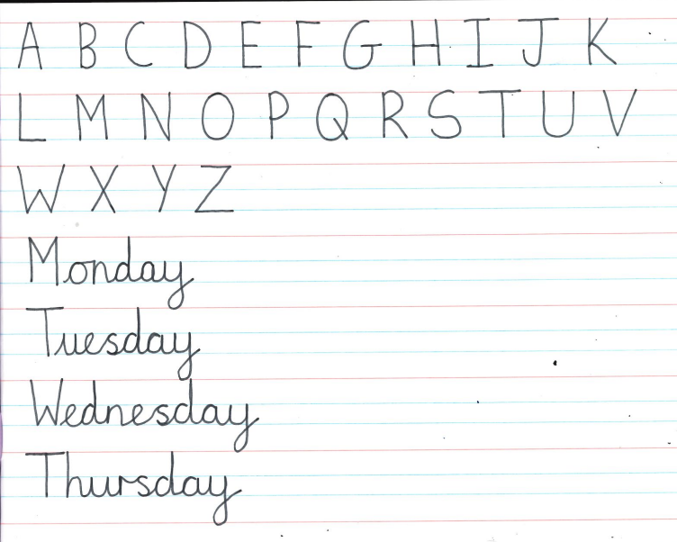
HANDWRITING
LESSON 3
19/01/21

Slide 4
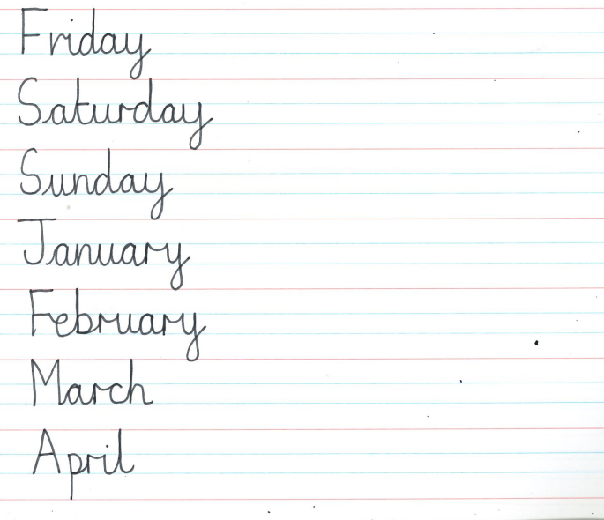
HANDWRITING
LESSON 4
21/01/21

Slide 5
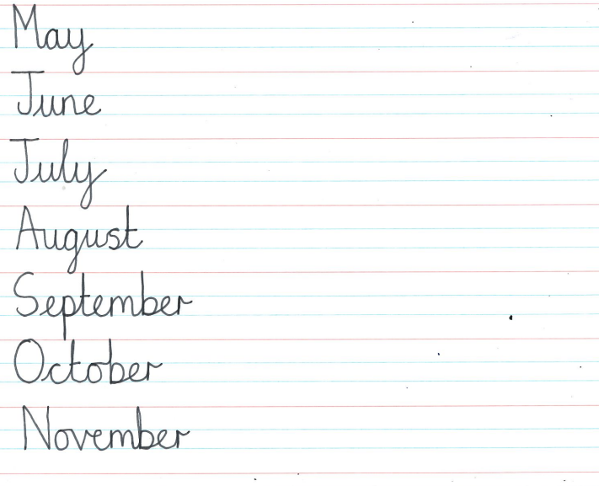
HANDWRITING
LESSON 5
26/01/21

Slide 6
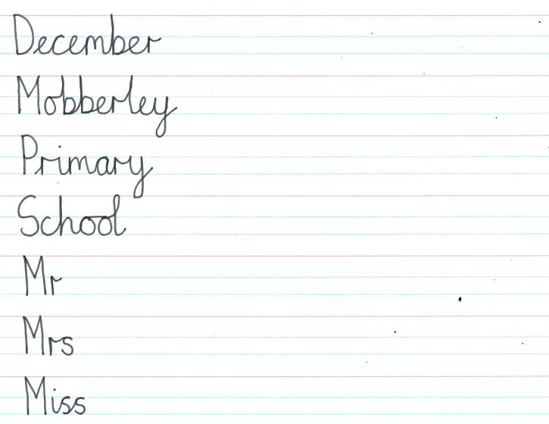
HANDWRITING
LESSON 6
28/01/21

Slide 7
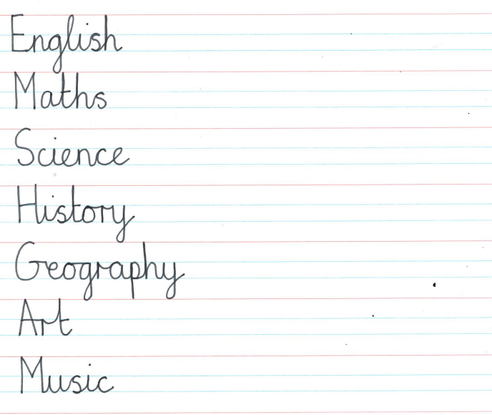
HANDWRITING
LESSON 7
02/02/21

Slide 8
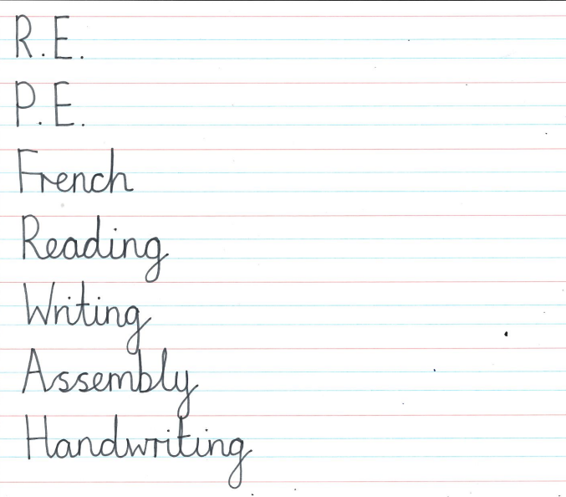
HANDWRITING
LESSON 8
04/02/21

Slide 9
HANDWRITING
LESSON 9
09/02/21

Slide 10
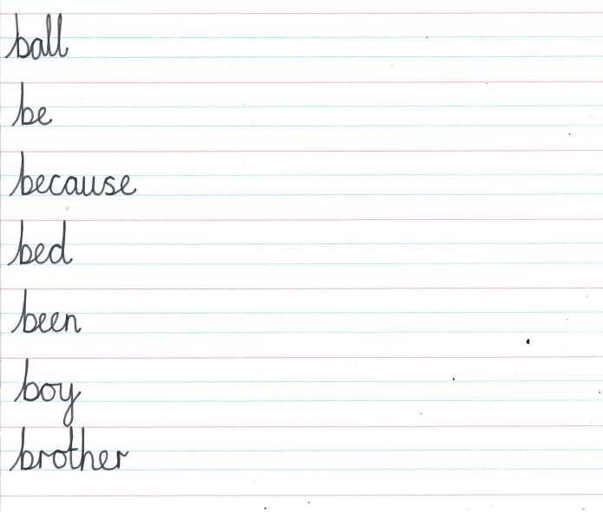
HANDWRITING
LESSON 10
11/02/21

