Slide 1
Animals

Slide 2
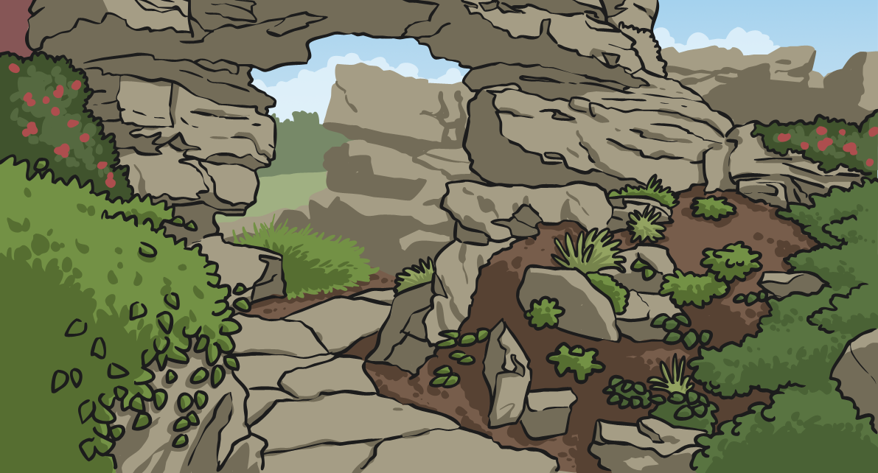
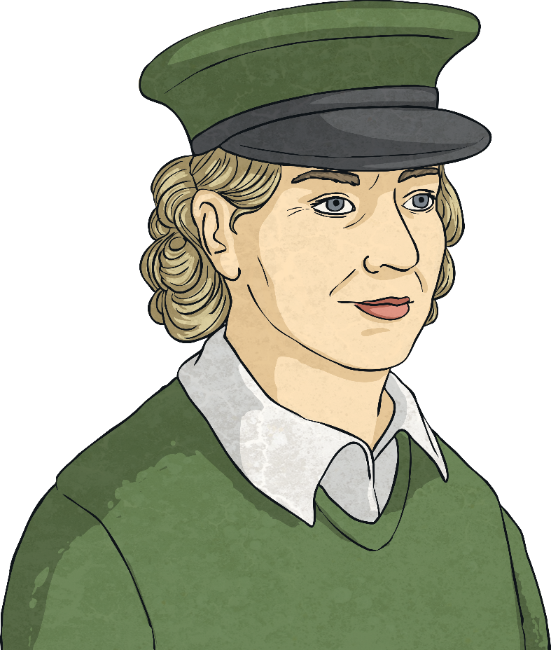
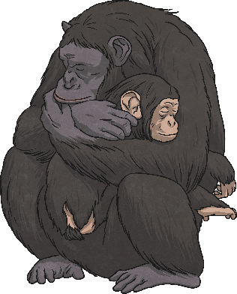
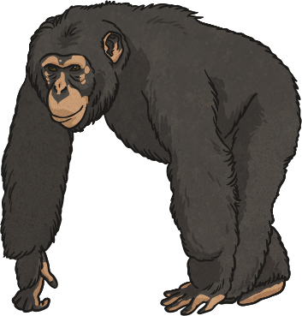
Which Has the Greatest Mass?
This is Zina the zookeeper.
Zina has weighed the animals in the zoo and needs to answer some questions about the measurements she has taken.
Can you help Zina work out which animal has the greatest mass?

Slide 3
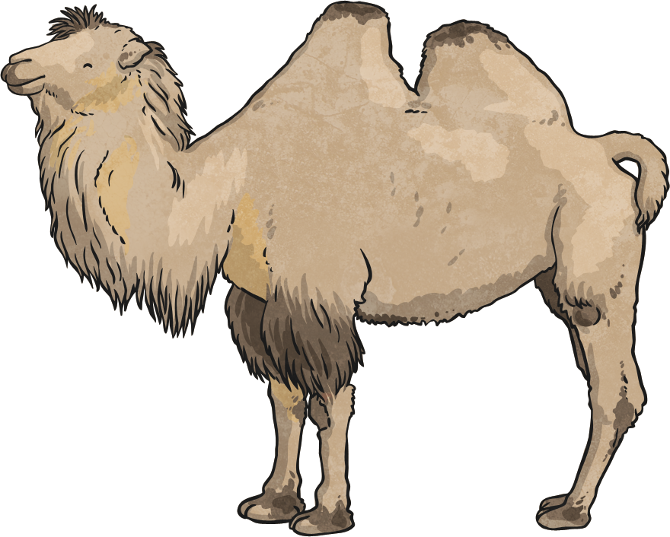
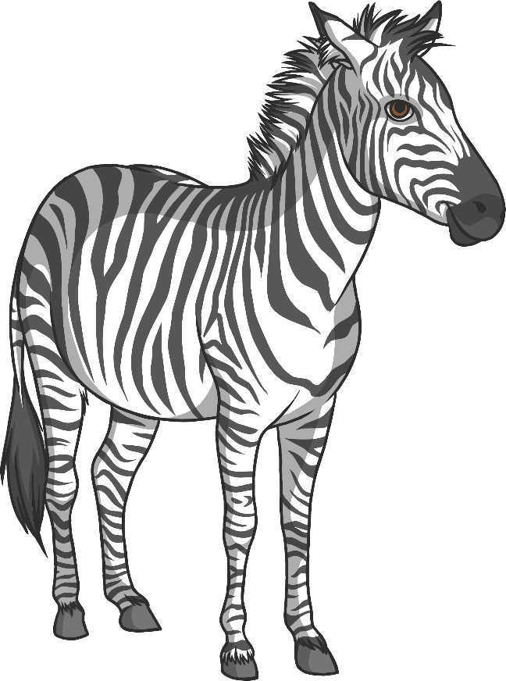
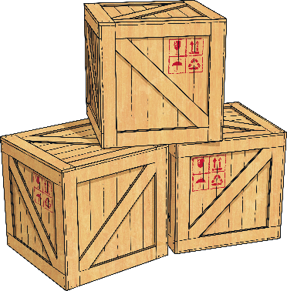
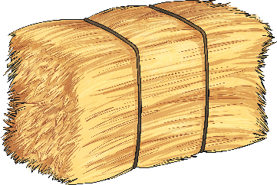
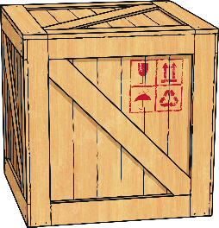
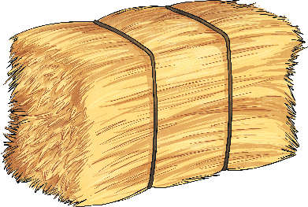
Which Has the Greatest Mass?
Which of these animals has the greatest mass?
zebra
350kg
Bactrian camel
480kg
The Bactrian camel has the greatest mass.

Slide 4
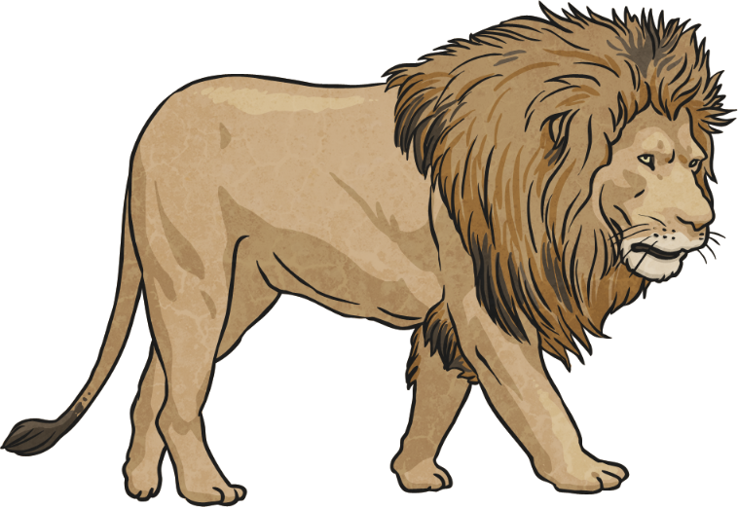
Which Has the Greatest Mass?
Which of these animals has the greatest mass?
tiger
310kg
lion
190kg
The tiger has the greatest mass.

Slide 5
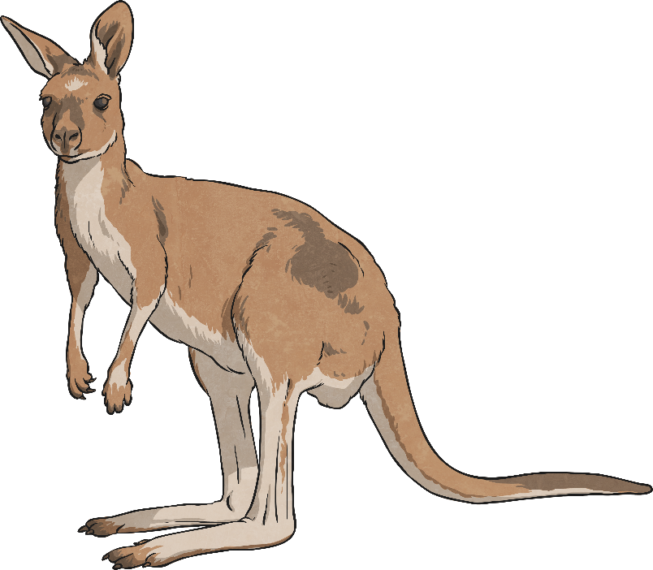
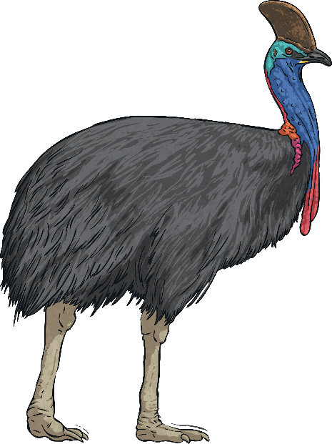
Which Has the Greatest Mass?
Which of these animals has the greatest mass?
cassowary
kangaroo
60kg
100kg
The kangaroo has the greatest mass.

Slide 6
Which Has the Greatest Mass?
Here are the masses of some other animals:

Slide 7
What Is their Combined Mass?
Zookeeper Zina is calculating the combined mass of certain animals.
Can you help her with the calculations?
200kg
160kg + 40kg =

Slide 8
What Is their Combined Mass?
Zookeeper Zina is calculating the combined mass of certain animals.
Can you help her with the calculations?
20kg
15kg + 5kg =

Slide 9
What Is their Combined Mass?
Zookeeper Zina is calculating the combined mass of certain animals.
Can you help her with the calculations?
350kg
40kg + 310kg =

Slide 10
What Is their Combined Mass?
Zookeeper Zina is calculating the combined mass of certain animals.
Can you help her with the calculations?
440kg
60kg + 30kg + 350kg =

Slide 11
What Is their Combined Mass?
Can you help Zina work out the difference in mass
between the animals?
250kg
350kg - 100kg =

Slide 12
What Is their Combined Mass?
Can you help Zina work out the difference in mass
between the animals?
165kg
200kg - 35kg =

Slide 13
What Is their Combined Mass?
Can you help Zina work out the difference in mass
between the animals?
130kg
480kg - 350kg =

Slide 14
What is the combined mass of the lion and the okapi?
What is the difference between the western gorilla and the lion?
What is the combined mass of the zebra, the lion and the okapi?

Slide 15
What is the combined mass of the tiger and the Bactrian camel?
What is the difference between the chimpanzee and the wombat?
What is the combined mass of the tiger, the wombat and the Bactrian camel?

