Slide 2
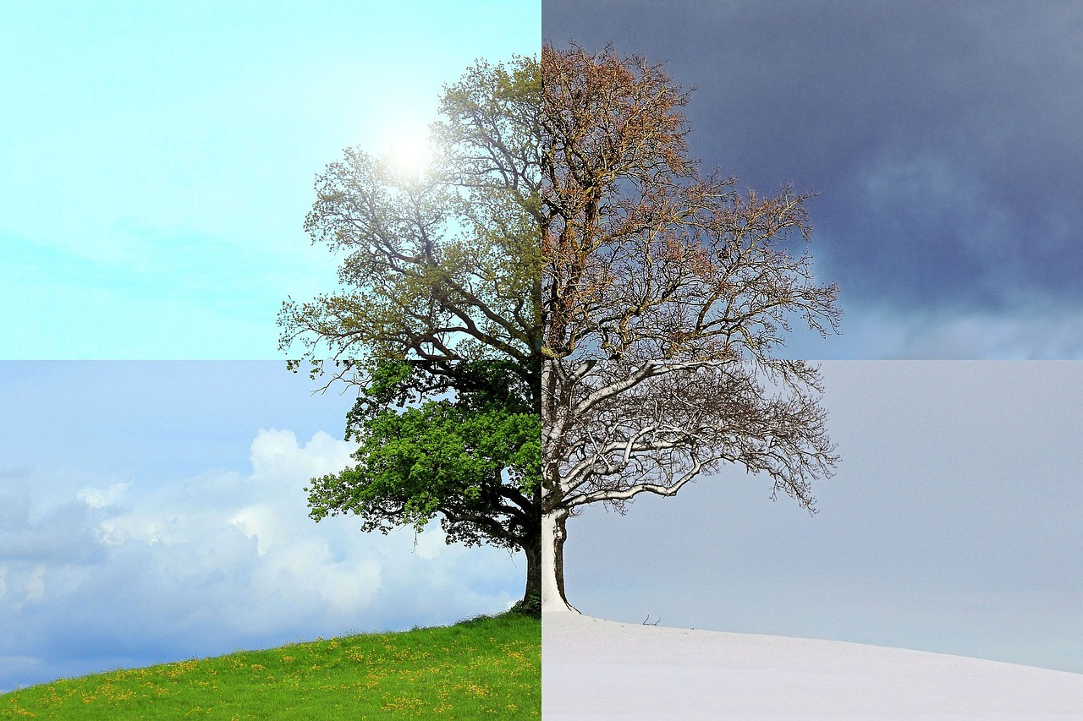
What Is Adaptation?
Adaptation is the process of change by which a species becomes better suited to its environment.

Slide 3
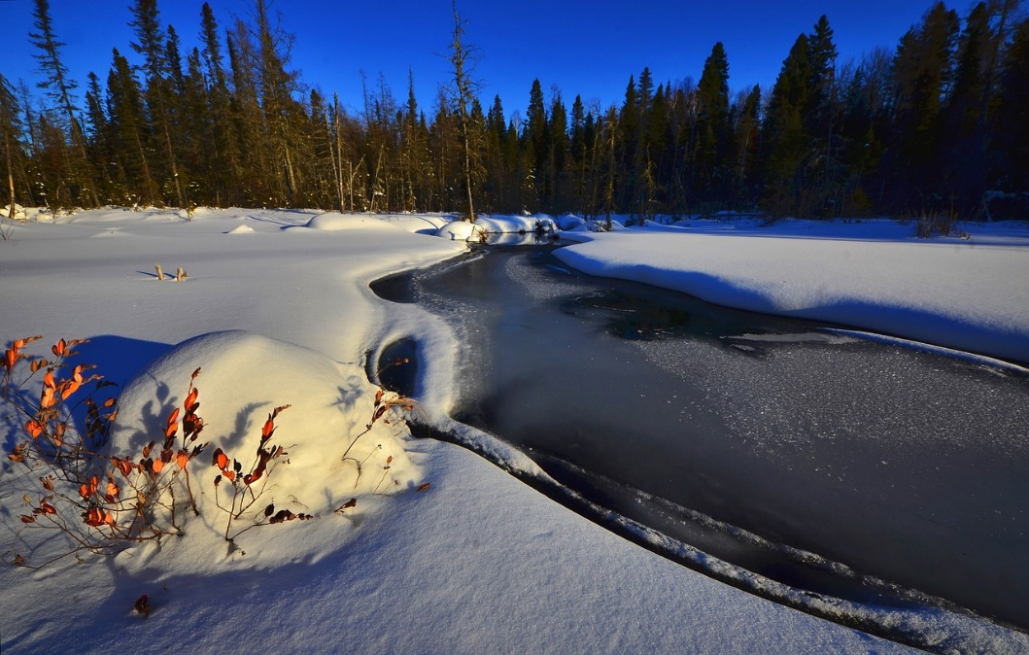
Why Must Animals Adapt?
Animals adapt when their natural habitat changes.
In Canada, winters can bring extreme changes in weather. In order to survive through the cold winters, animal species must adapt.

Slide 4
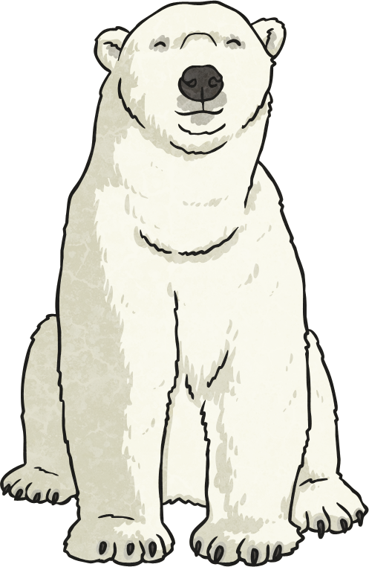
How Do Animals Adapt?
Each animal has certain features that helps it adapt to its environment. For example, the polar bear does not hibernate in winter like the grizzly bear does. Polar bears have features that help them adapt to the cold:
They have thick fur coats.
They have a layer of fat under their fur.
They have hair on their paws that helps them avoid slipping on the ice.

Slide 5
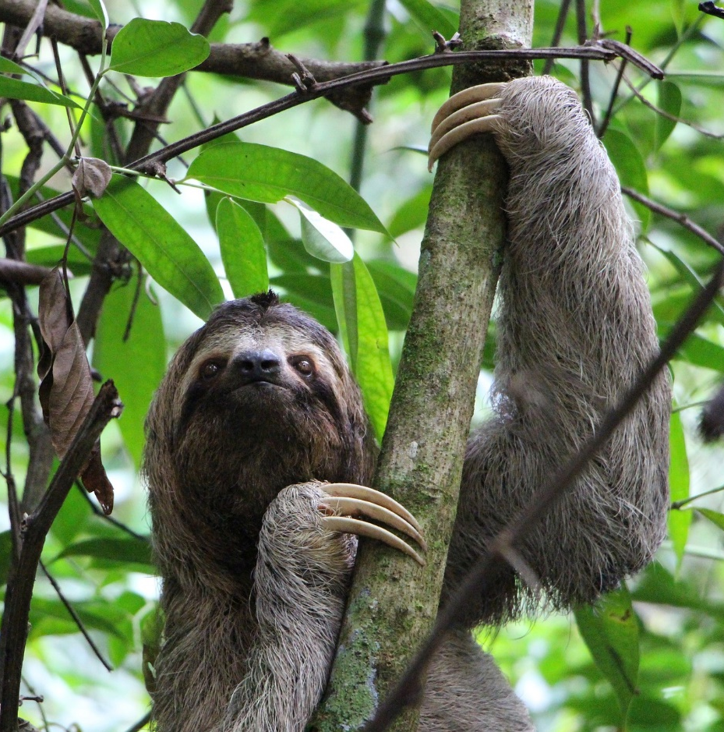
Sloth
Sloths are adapted to survive in tropical rainforests. They have very sharp claws which helps them to climb trees.
Sloths spend most of their lives in tree tops to avoid the predators living on the floor of the rainforest. Green algae grows on sloths fur which help to camouflage sloths from their predators.

Slide 6
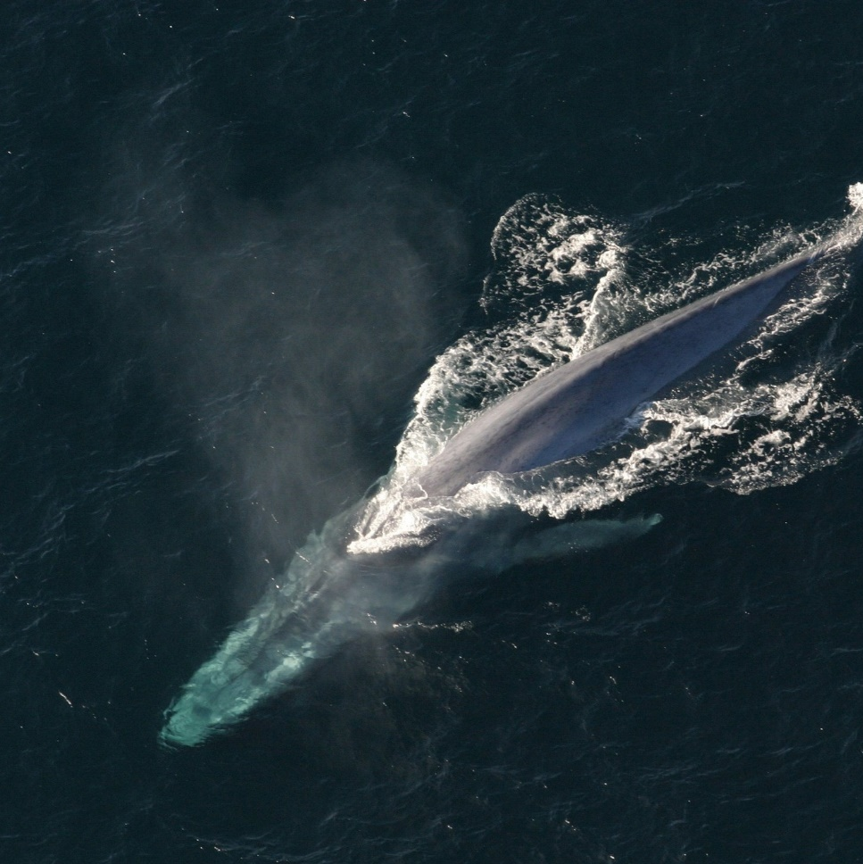
Whale
Whales are adapted to help them survive in the oceans. They are streamlined and can travel through water easily using their flippers.
Whales are warm-blooded mammals and have a thick layer of blubber under their skin to keep them warm. They have blow holes on top of their heads which let them breathe air in and out.

Slide 7
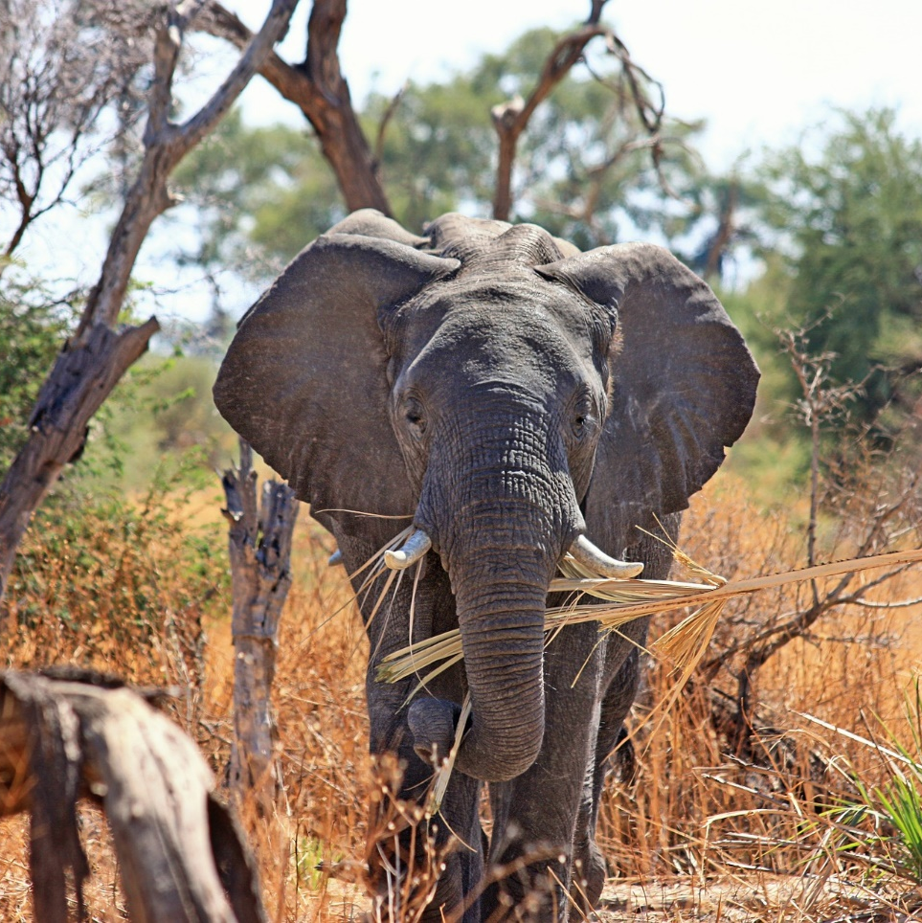
Elephant
Elephants eat plants and are adapted to survive in savannahs, forests and deserts. Their cushioned feet help them to walk silently which helps them avoid predators.
Elephants have very large ears to cool them down. They also have a long trunk which they use for many things including showering, making trumpeting sounds and picking things up.

Slide 8
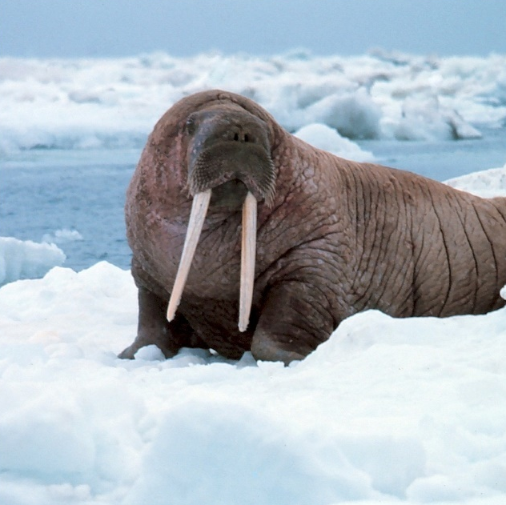
Walrus
A walrus is adapted to live in very cold places. The bottom of a walrus’ flippers are bumpy to help them grip onto the ice. A walrus’ tusks help them climb out of the water.
They have a thick layer of fat to protect them from getting too cold.

Slide 9
Porcupine
Porcupines are adapted to live in forests. They have sharp quills to help them if they are in trouble with another animal.
They are great tree climbers because they have thick pads under their paws.

Slide 10
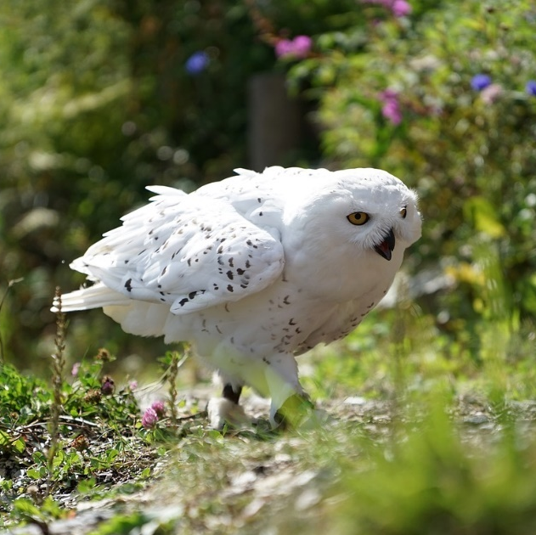
Snowy Owl
Snowy owls are adapted to live in cold places. They have thick layers of feathers to keep them warm. They are white to help them camouflage in the winter. Their legs are also covered in feathers to keep them from getting cold.
Snowy owls are well adapted predators. They have large eyes to help them see their prey and asymmetric ears help them to hear their prey. Their silent feathers help them to sneak up silently on their prey and catch it!

Slide 11
Do Humans Adapt?
Yes
Humans have the ability to adapt to changes in their environment.
Think about what happens when you go swimming or take a bath. Does your body adapt to the water in any way?
Your fingers become wrinkled! Your body does this in order to help your fingers grip onto things, even in the water!

Slide 12
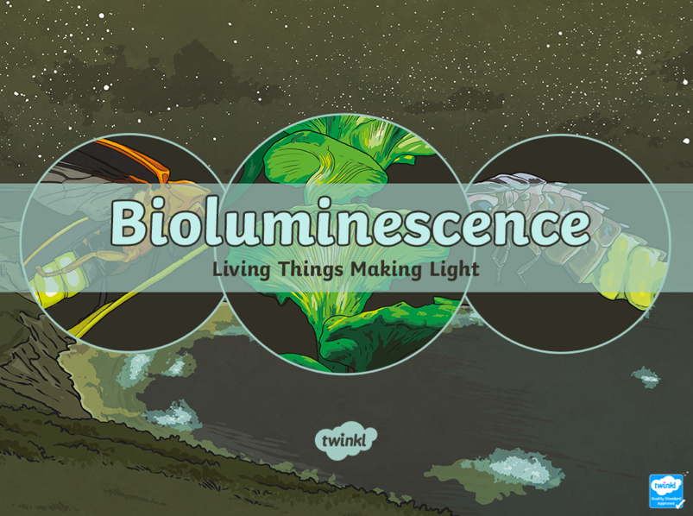

Slide 13
Let There Be Light!
Biologist William Beebe helped discover many marine species in the deep sea that glowed. These organisms had glowing spots in certain helpful places or glowing patterns on their bodies. Some glowing organisms that are found in the water include;
Anglerfish
Crystal jellyfish
Bathocyroe fosteri (jellyfish)
Tomopteris
Moon jellyfish
Atolla jellyfish
Clusterwink snail
Black dragonfish
Other glowing organisms can include certain types of;
Small invertebrates
Fungi
Flies
Worms
Snails

Slide 15
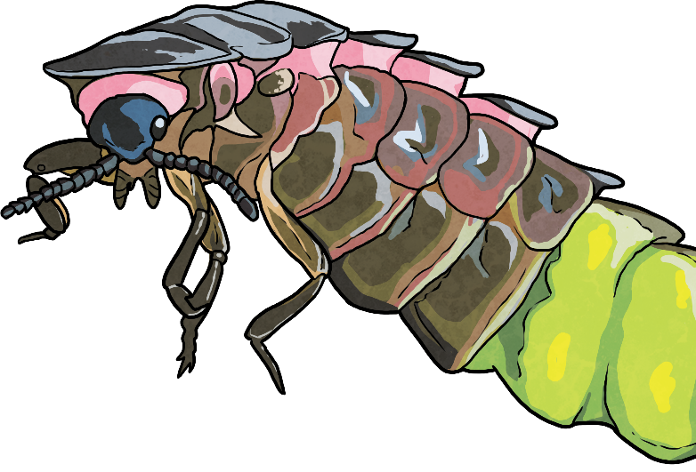
Why?
It is thought that bioluminescence is used by organisms to lure prey, communicate, deal with a build-up of harmful chemicals and protect against predators.
Answers Coming to Light
We still do not know why many organisms use bioluminescence. Research is being done by scientists to discover why some living things want or need to create their own light. They are trying to answer questions like;
Why would a fungi use light?
What use is light to a worm living in the dark soil?
How is the light helpful to the organism creating it and other organisms?
The search is on to find more living things that can create their own light. However, discovering them is a real challenge as they can only be seen in the dark.

