Slide 1
Classifying Animals
Year 6 week beginning 15/6/20
ypte.org.uk

Slide 2
Scientists estimate that Planet Earth is home to 8.7 million species.
Classification makes sense of this huge diversity.
Photo: Zappys Technology Solutions
ypte.org.uk

Slide 3
Aristotle 384BC – 322BC
Aristotle was the first person to try and classify living things into groups.
“In all things of nature there is something of the marvellous”
Photo: Elizabethe

Slide 4
Aristotle’s Ladder of Life
Human Beings
Can think and be creative
Animals
Can move around to search for food and escape predators
Sensitive to their surroundings
Plants
Usually green and stationary
Can grow and reproduce
Non-living Things
e.g. rocks

Slide 5
Carolus Linnaeus 1707 - 1778
Linnaeus made it his life’s work to develop a way to classify and name all life on Earth
Photo: Stuart Rankin

Slide 6
The Seven Levels of Linnaeus’ System
Kingdom
Phylum
Class
Order
Family
Genus
Species
This phrase will help you remember the order:
Keep ponds clean or frogs get sick
More specific

Slide 7
Panthera leo (lion)
Kingdom:
Animalia
Phylum:
Chordata
Class:
Mammalia
Order: Carnivora
Family: Felidae
Genus: Panthera
SpeciesLeo
Backbone
Hair/fur, live young etc
Meat eating
Retractable claws
Roars
Photo: Chester Zoo

Slide 8
The Five Kingdoms
Kingdoms
monera
protista
plants
fungi
animals
The first big division of living things is to put them into one of the five kingdoms.

Slide 9
Kingdom Animalia
Includes all multi-cellullar animals
Cannot make their own food
Around 1,500,000 species – more than in all the other kingdoms combined
Photo: Josep Ramis

Slide 10
How Can We Group Animals?
Animals
Vertebrates
Invertebrates
Mammal
Bird
Reptile
Amphibian
Fish
Arthropod
Annelid
Mollusc
Echinoderm
Cnidarian
Sponge

Slide 11
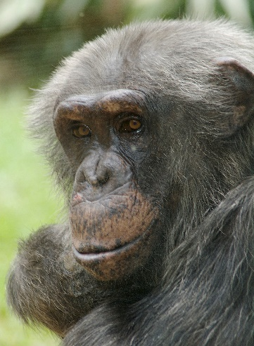
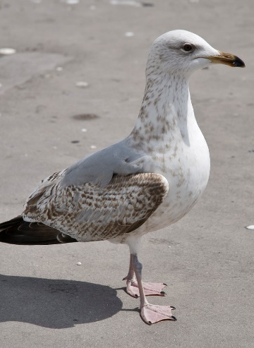
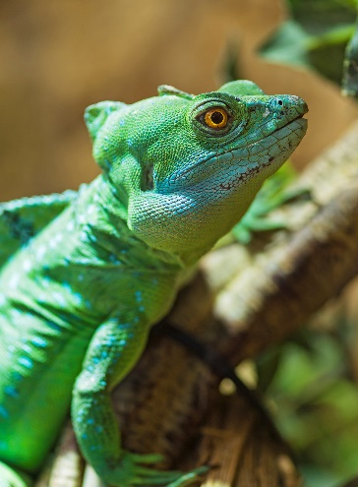
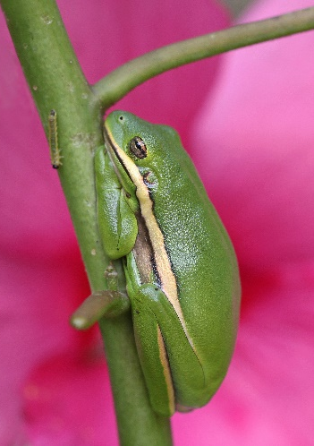
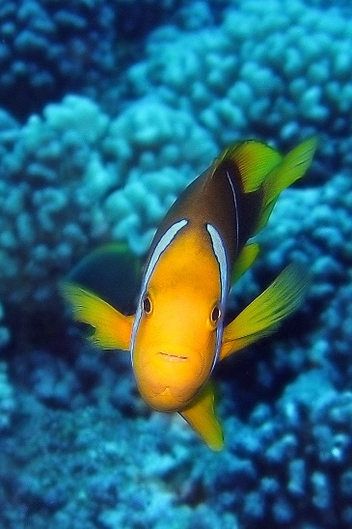
Vertebrates
Animals can be divided into 2 groups based on the presence or absence of a backbone.
Vertebrates are animals with a backbone
Photo: Valerie
Photo: Berit Watkin
Photo: Tambako The Jaguar
Photo: Vicki DeLoach
Photo: SF Brit
Mammals
Birds
Reptiles
Amphibians
Fish
Vertebrates can be further divided into 5 groups. Animals in each group share certain features.

Slide 12
Mammals
(Phylum Chordata, Class mammalia)
Vertebrate
Warm-blooded
Grow hair or fur
Females produce milk to feed young
Give birth to live young
Lungs to breathe
About 5,000 species
Found on land, in oceans and freshwater
mouse, lion, monkey, whale, human

Slide 13
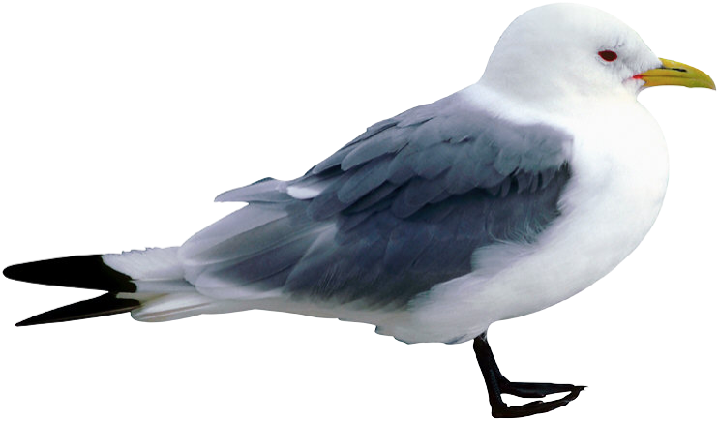
Birds
(Phylum Chordata, Class aves)
Vertebrate
Warm-blooded
Feathers
Two legs
Lay eggs
Two wings
About 10,000 species
Found flying in skies, swimming in seas, wading in lakes & rivers
parrot, pigeon, penguin

Slide 14
Reptiles (Phylum Chordata, Class reptilia)
Vertebrate
Dry skin
Scaly skin
Cold-blooded
Usually lay eggs
Breathe air
Over 5,000 species (most of these are snakes and lizards)
Found on land, in oceans & freshwater
crocodile, snake, lizard, turtle

Slide 15
Amphibians (Phylum Chordata, Class Lissamphibia)
Vertebrate
Moist scaleless skin
Cold-blooded
Breathe oxygen through lungs
Lay eggs
Live on land and in water
About 5,000 species
Found on land and in freshwater
frog, toad, newt, salamander

Slide 16
Bony Fish (Phylum Chordata, Class Osteichthyes)
Vertebrate
Cold-blooded
Covered with scales
Thin paired fins
Breathe underwater through gills
Bony skeletons
Lay lots of eggs
About 25,000 species
Make up most of the fish that swim in seas, rivers & lakes
salmon, tuna, goldfish, seahorse

Slide 17
Cartilaginous Fish (Phylum Chordata, Class Chondrichthyes)
Vertebrate
Skeletons made of cartilage
Fleshy fins
Almost all have internal fertilisation
Breathe underwater through gills
Must swim continuously to stay afloat
Cold-blooded
About 850 species
Found mainly in the sea
shark, ray, skate, sawfish, guitarfish, ratfish

Slide 18
Platypus: Mammal or Bird?
Photo: Long Road Photography
Has brown fur and a tail like a beaver
Has a bill and lays eggs like a duck
What is it?

Slide 19
Invertebrates
About 97% of animals are invertebrates.
There are about 30 million species in the world!
Invertebrates
Arthropods
Sponges
Molluscs
Worms
Cnidarians
Echinoderms

Slide 20
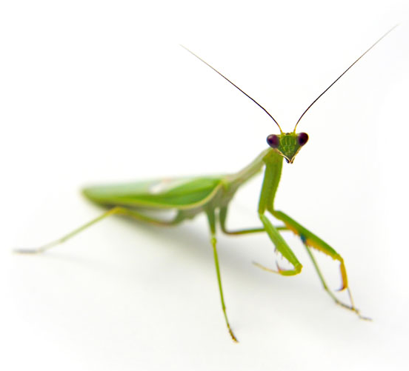
Arthropods (Phylum Arthropoda)
Over 1,000,000 species
Found on land, in oceans & freshwater
Invertebrates with exoskeletons, segmented bodies & jointed limbs
Photo: Federico Rodriguez

Slide 21
Arthropod: Insect (insectum)
3 parts to their bodies
2 eyes
2 antennae
6 jointed legs at some point in their lives
Often have wings
wasp, bee, butterfly, moth, beetle, ant, fly, dragon fly, praying mantis
Photo: Kathi

Slide 22
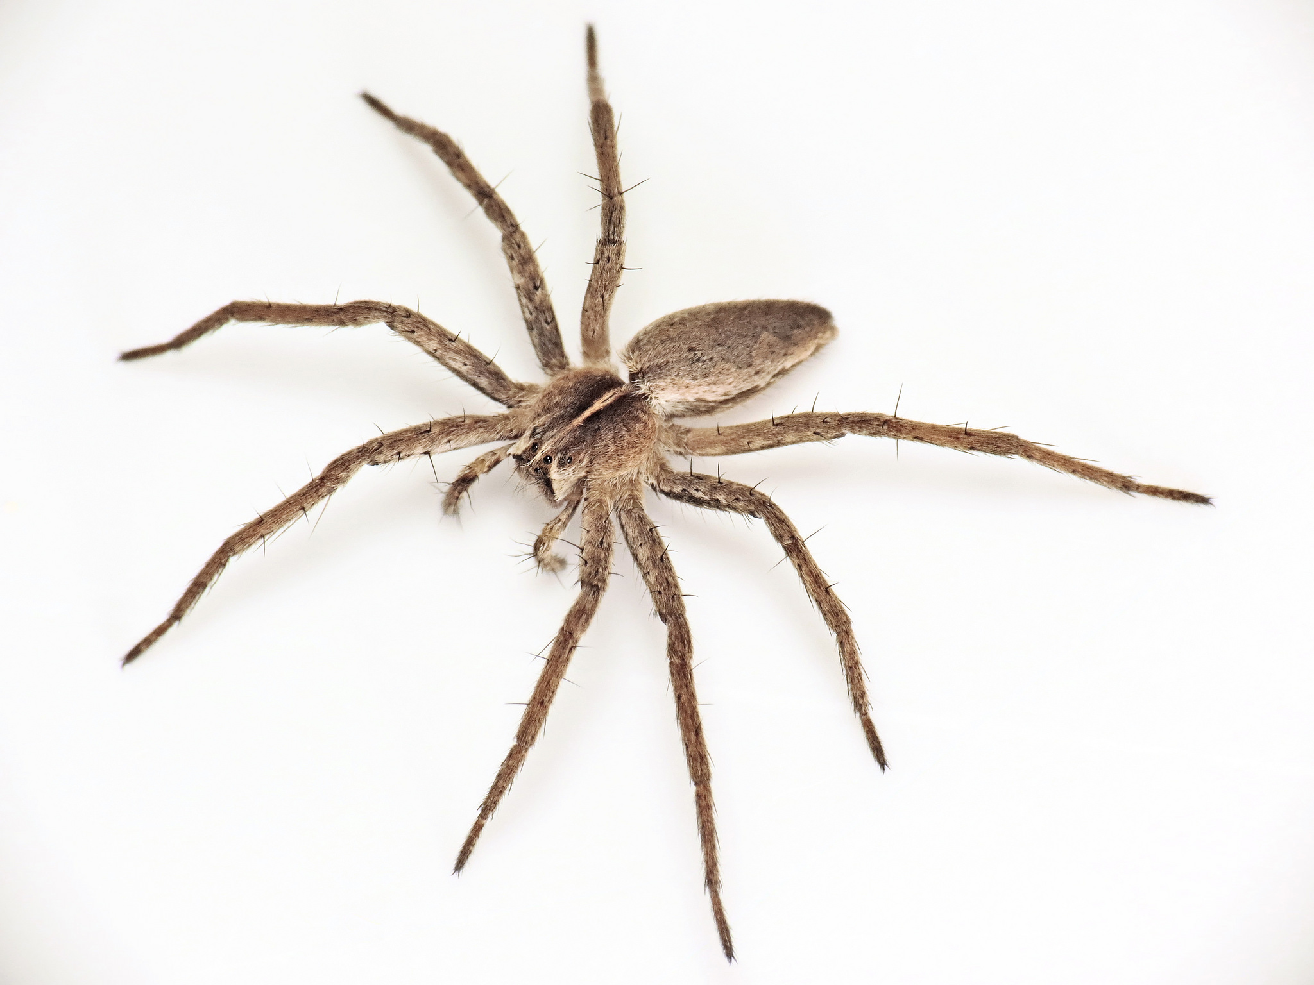
Arthropod: Arachnid (arachnida)
spider, scorpion, tick, mite,
daddy-long-legs (harvestman)
2 parts to their body
8 legs
2 pincers for biting or piercing prey
No antennae
Photo: Martin Cooper

Slide 23
Arthropod: Myriapod (myriapoda)
About 15,000 species
Most have many pairs of legs
2 body sections (head and trunk)
One pair of antennae on head
Photo: Colin Avison
Centipede, millipede

Slide 24
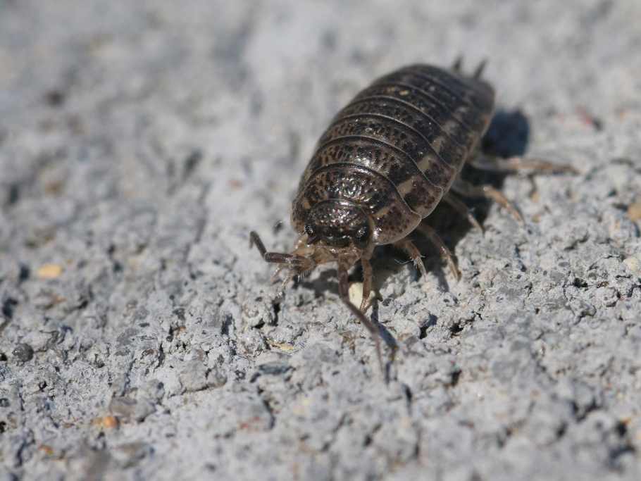
Arthropod: Crustacean (crustacea)
A hard outer shell or case
10-14 legs
2 pairs of antennae
woodlouse, crab, lobster, barnacle, shrimp
Photo: sankax

Slide 25
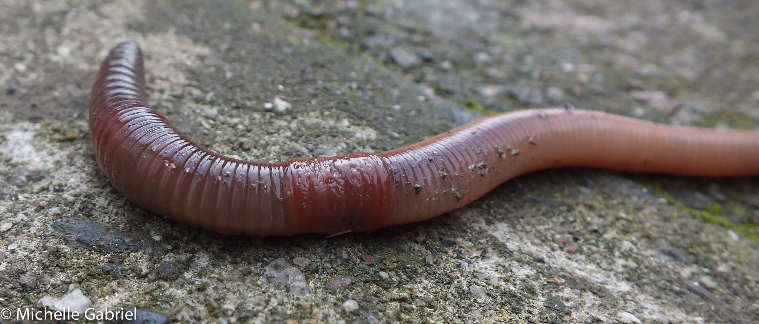
Worms
(Phyla Annelida, Nematoda & Platyhelminthes)
No true limbs
Body shapes vary but the two sides of their bodies are always symmetrical
Some live inside other animals, others in water or on land
Earth worm, flat worm, round worm, leech

Slide 26
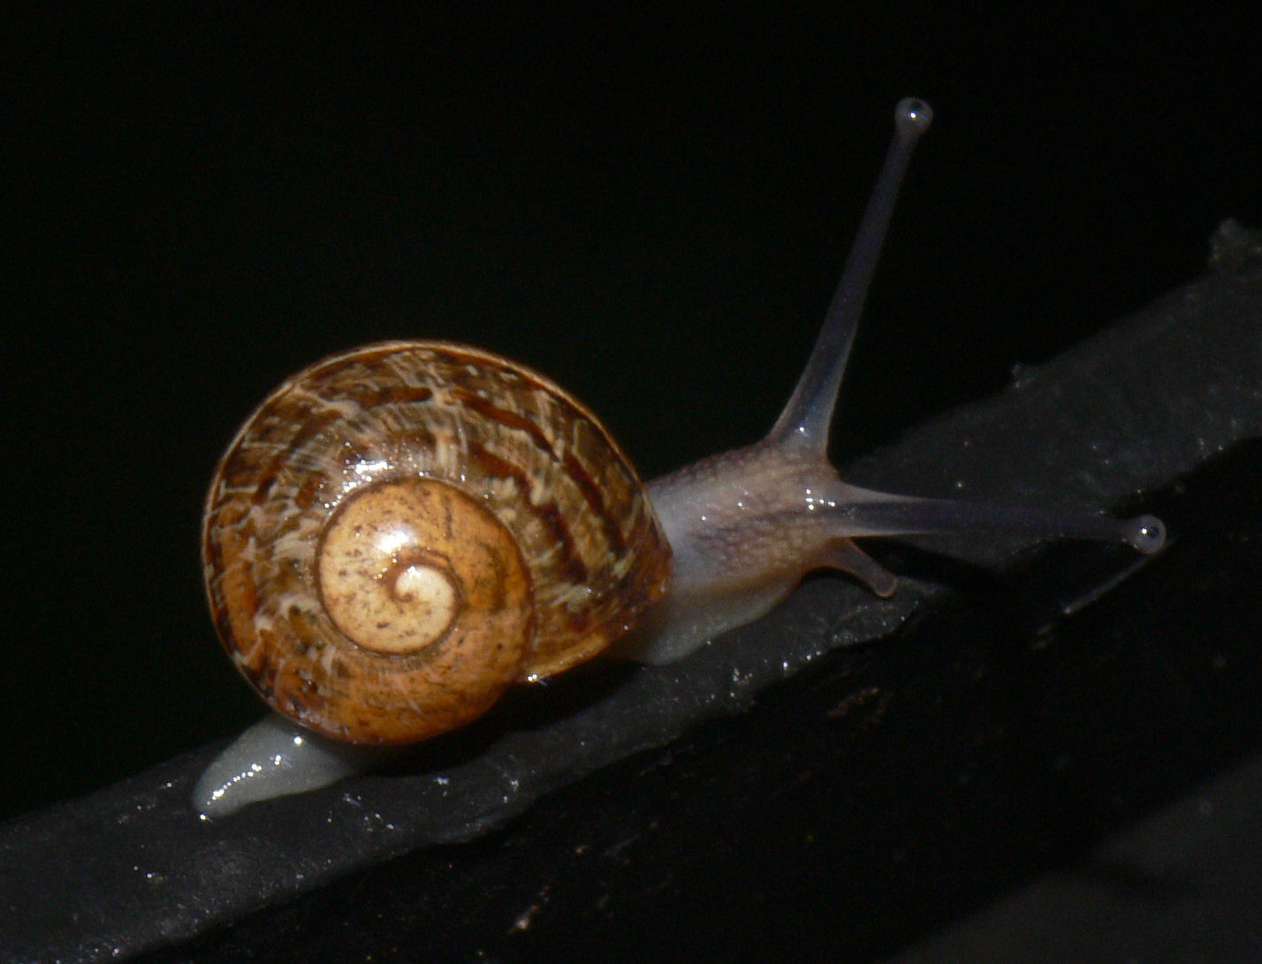
Molluscs (Phylum Mollusca)
One main part to their body
Soft bodies, many have a shell
All have one muscly foot or tentacles to help them move around
Most are slimy to help them slide along the ground
snail, slug, octopus, oyster, mussel, clam, squid
Photo: bramblejungle

Slide 27
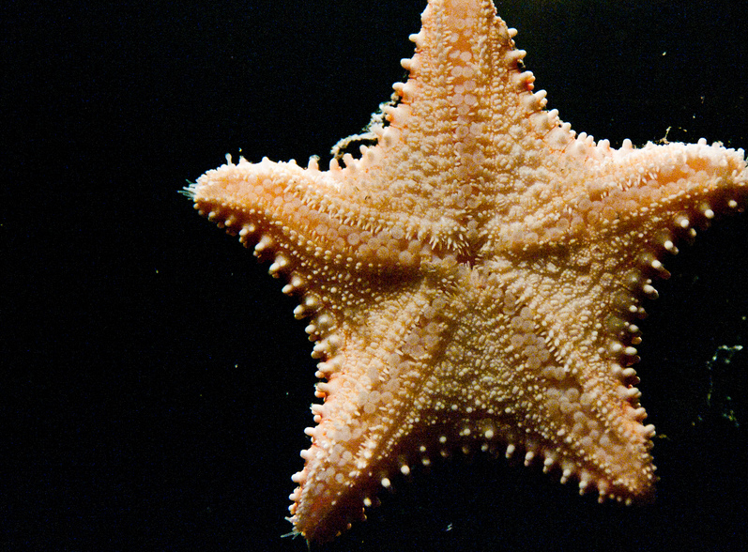
Echinoderms (Phylum: Echinodermata)
Photo: Selbe Lynn
Found only in the ocean
Most have arms or spines that radiate from the centre of their body
star fish, sea urchin, sea cucumber

Slide 28
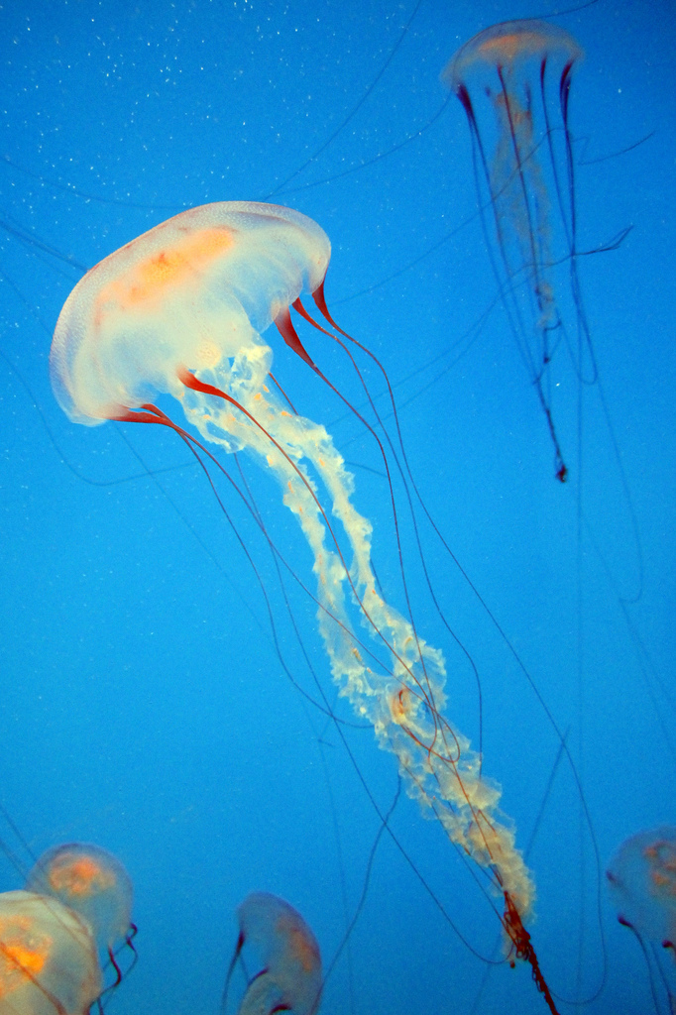
Cnidarians (Phylum Cnidaria)
Photo: Wally Gobetz
Found in oceans and freshwater
Most have a ring of tentacles around mouth – stinging cells on these catch prey
jellyfish, coral, sea anemone

Slide 29
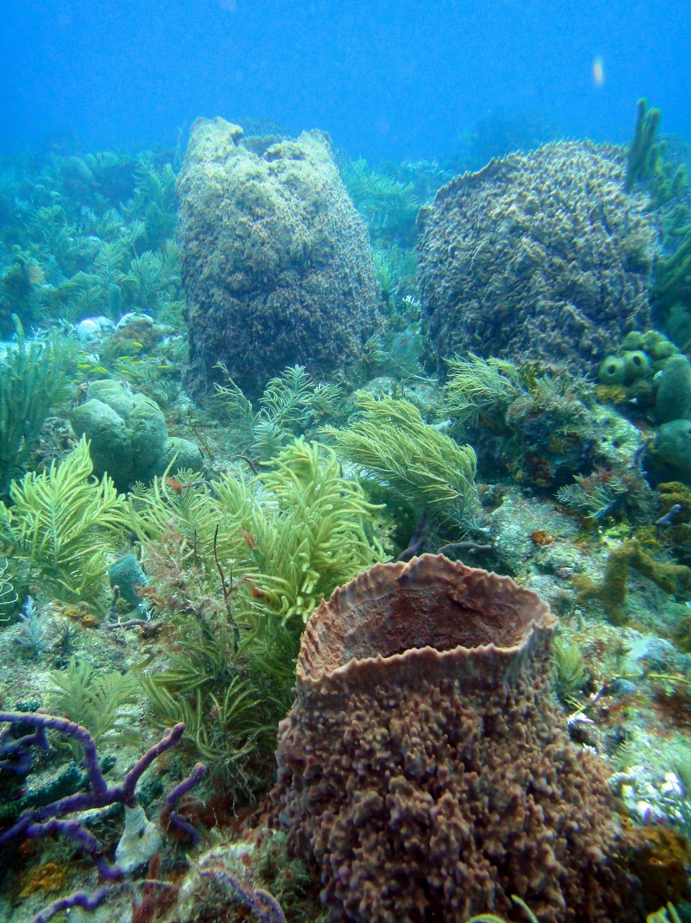
Sponges (Phylum Porifera)
Photo: Matt Kieffer
Usually fix themselves to rocks on sea bed
May look like seaweed or other plants, but are definitely animals as they do not make their own food.

