Slide 1
Sustainable Development
29/6/20

Slide 2
Look at each of these slides:
Can you explain what the problem is and what causes it?
Can you think about what could be done to reduce the problem?
How can you help in any way at home or at school?
Can you think of any other types of damage that humans are causing to our planet?

Slide 3
Photo: Steve Snodgrass

Slide 4
Photo by Mary

Slide 6
Photo by Wisconsin Dept of Natural Resources

Slide 7
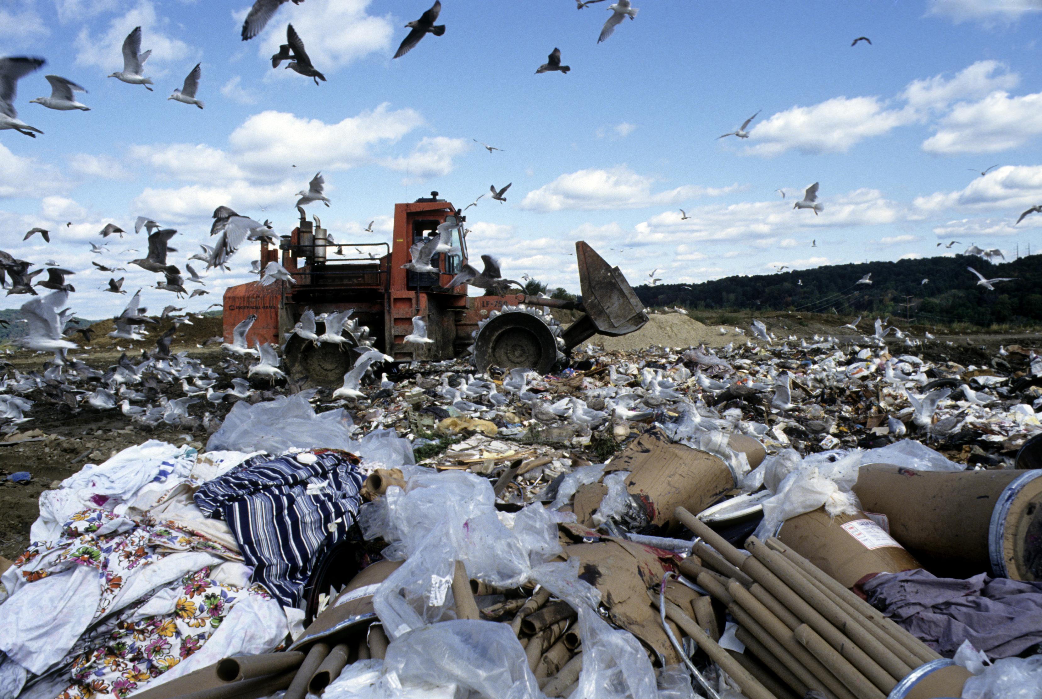
Photo: United Nations

Slide 8
Photo: Crustmania

Slide 9
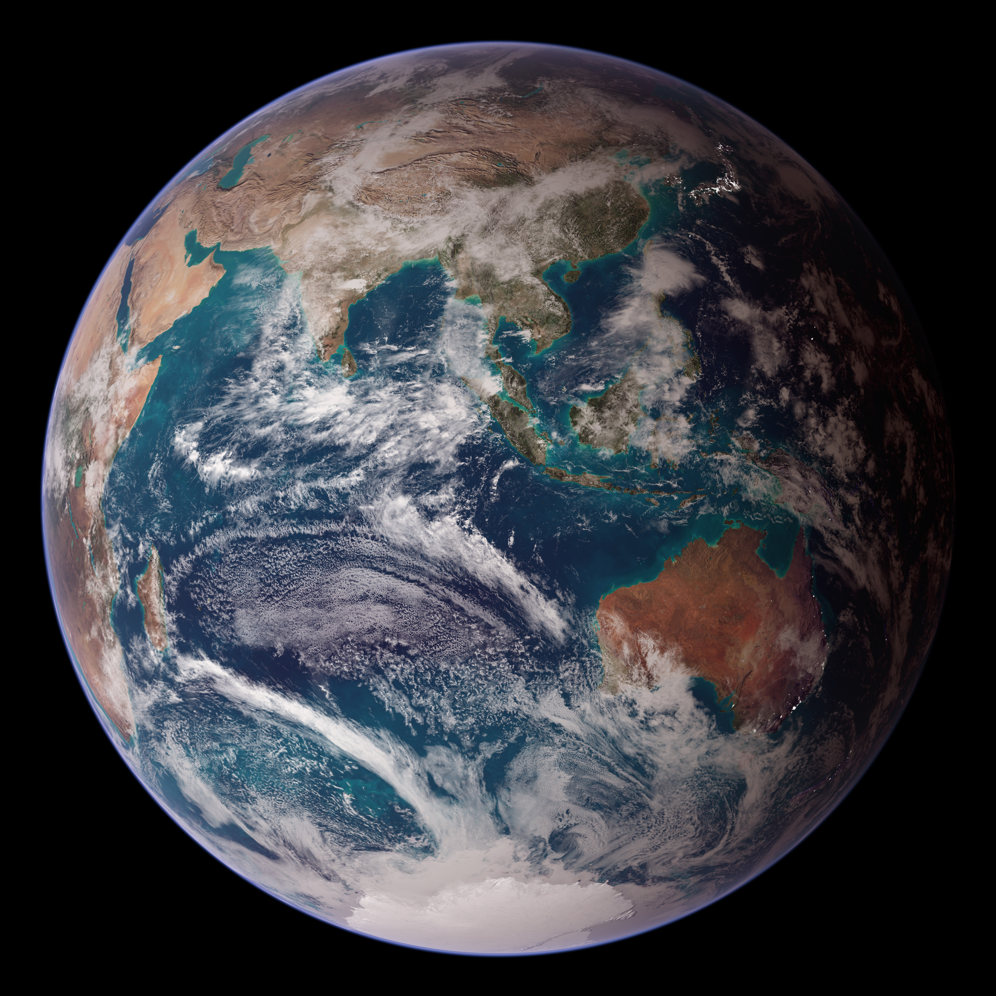
Photo: NASA/Goddard Space Flight Center/Reto/Stöckli

Slide 10
Sustainable Development
Improving our quality of life without damaging the quality of life for future generations

