Slide 1
19/6/20 Year 6 Writing
LOST!

Slide 2
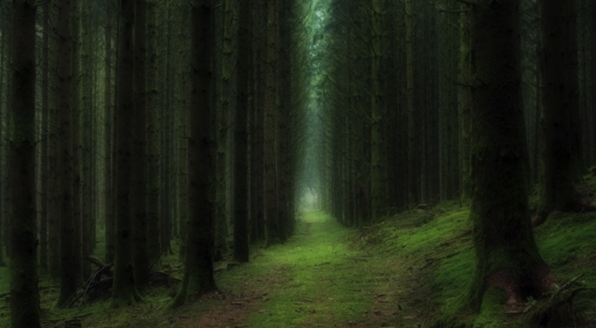

Slide 3
READ and then answer the questions on the next slide: Hours and hours had passed, and she hadn’t seen a soul. The monotony of trudging through this seemingly never-ending labyrinth was tiring, and her eyelids felt heavy. The heady scent of the pine sap and earthy moss added to her lethargic state. She felt as if she could close her eyes and sleep for a thousand years. She knew she couldn’t though; being trapped in the woods when night fell wouldn't be a wise move. Making the most of the remaining daylight would be crucial, she knew. A great sense of foreboding filled her, and she had a tight feeling in her chest. The trees around her, like sentinels protecting the gods of the forest, seemed to bear down upon her. The dense army of pine trees threatened her from every side. There was only one path forward, and she took it hesitantly, not knowing what awaited her in the distance…

Slide 4
What does the fact that she is ‘trudging’ through the forest tell you about how she is feeling?
What does ‘lethargic’ mean?
Why would ‘making the most of the remaining daylight’ be crucial?
Why are the trees compared to sentinels?
What might happen in the forest when night falls? What is she so afraid of?
Who might ‘she’ be?
Have you ever been lost? What does it feel like?

Slide 5
Grammar/punctuation challenge
Add adverbs to my sentences below to make them better.
The girl was frightened. ______, she looked around at the surrounding forest. She began to walk ________ along the path, pausing________ to take a sip of water from her canteen.
From the distance ahead, she heard a scream. The sound echoed ________ through the forest.

Slide 6
Continue the story
Hours and hours had passed, and she hadn’t seen a soul. The monotony of trudging through this seemingly never-ending labyrinth was tiring, and her eyelids felt heavy. The heady scent of the pine sap and earthy moss added to her lethargic state. She felt as if she could close her eyes and sleep for a thousand years. She knew she couldn’t though; being trapped in the woods when night fell wouldn't be a wise move. Making the most of the remaining daylight would be crucial, she knew.
A great sense of foreboding filled her, and she had a tight feeling in her chest. The trees around her, like sentinels protecting the gods of the forest, seemed to bear down upon her. The dense army of pine trees threatened her from every side. There was only one path forward, and she took it hesitantly, not knowing what awaited her in the distance…
Continue the story.

