Slide 1
12/6/20 Year 6 Writing
The Environment

Slide 2
For a long time, scientists have warned the world to take better care of our planet before we completely ruin it.
The pictures on the next slides shows what is happening to the plastic in our world.
Once you have looked at the pictures, read the example report, which tells us why and how we can help our environment.
Using the pictures and the examples in the example report, write your own report that has a title ‘Save Our Environment!’

Slide 3
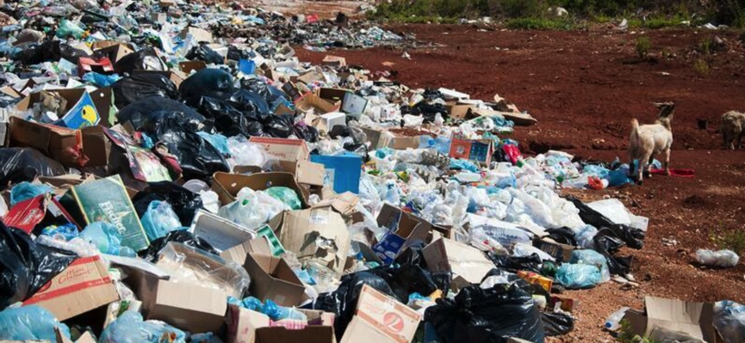

Slide 4
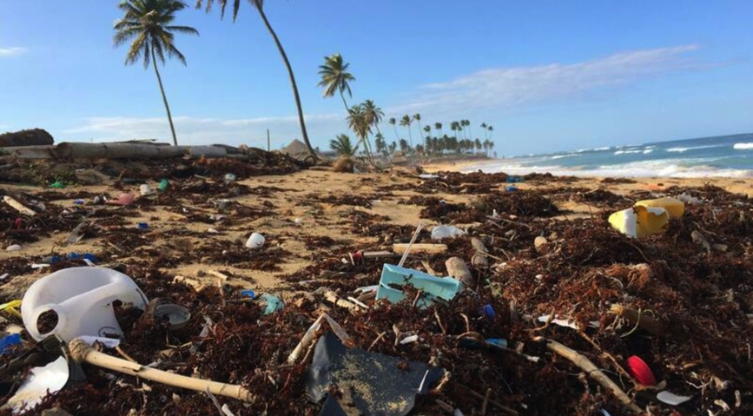

Slide 5
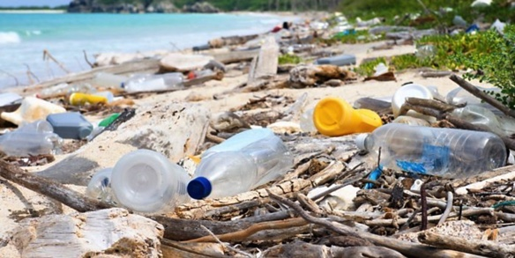
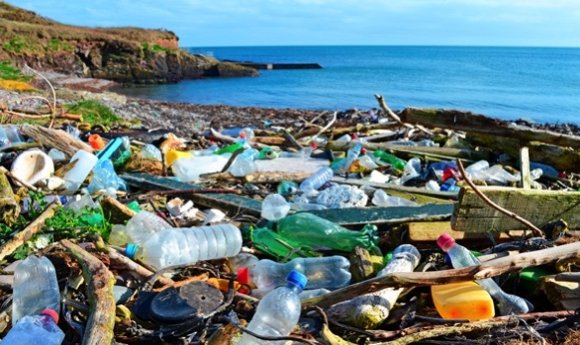

Slide 6
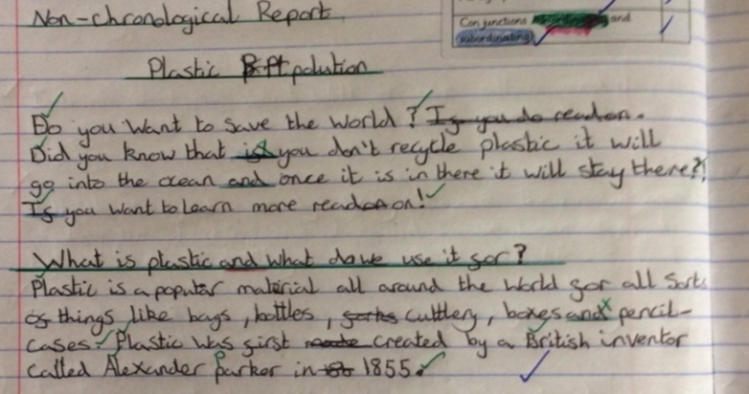

Slide 7
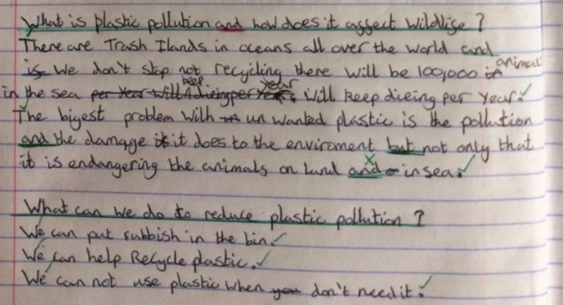

Slide 8
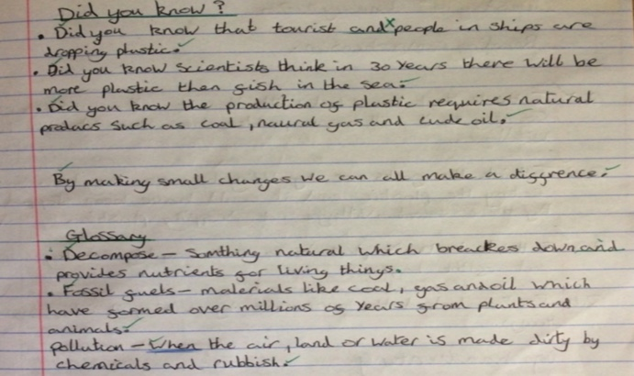

Slide 9
